Slide 1

MSc Textile Design, Technology and Innovation
Sustainability impact
Dr Angela Davies
Notes:
1

Slide 2

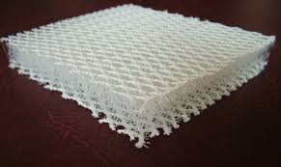
Our course
Our course brings together technology, design and product development into a diverse learning environment, bridging the gap between specific design and technical understanding
The focus for our students is to gain knowledge across a number of areas including garment and product technology, intimate apparel, performance and sportswear, textile technology and innovation, material chemistry, fabric construction, and sustainable and ethical practices
Sustainability is embedded within the entire course however more prominent in our core modules and theme is followed through to FMP’s and post DMU into careers/ PhD studies

Slide 3
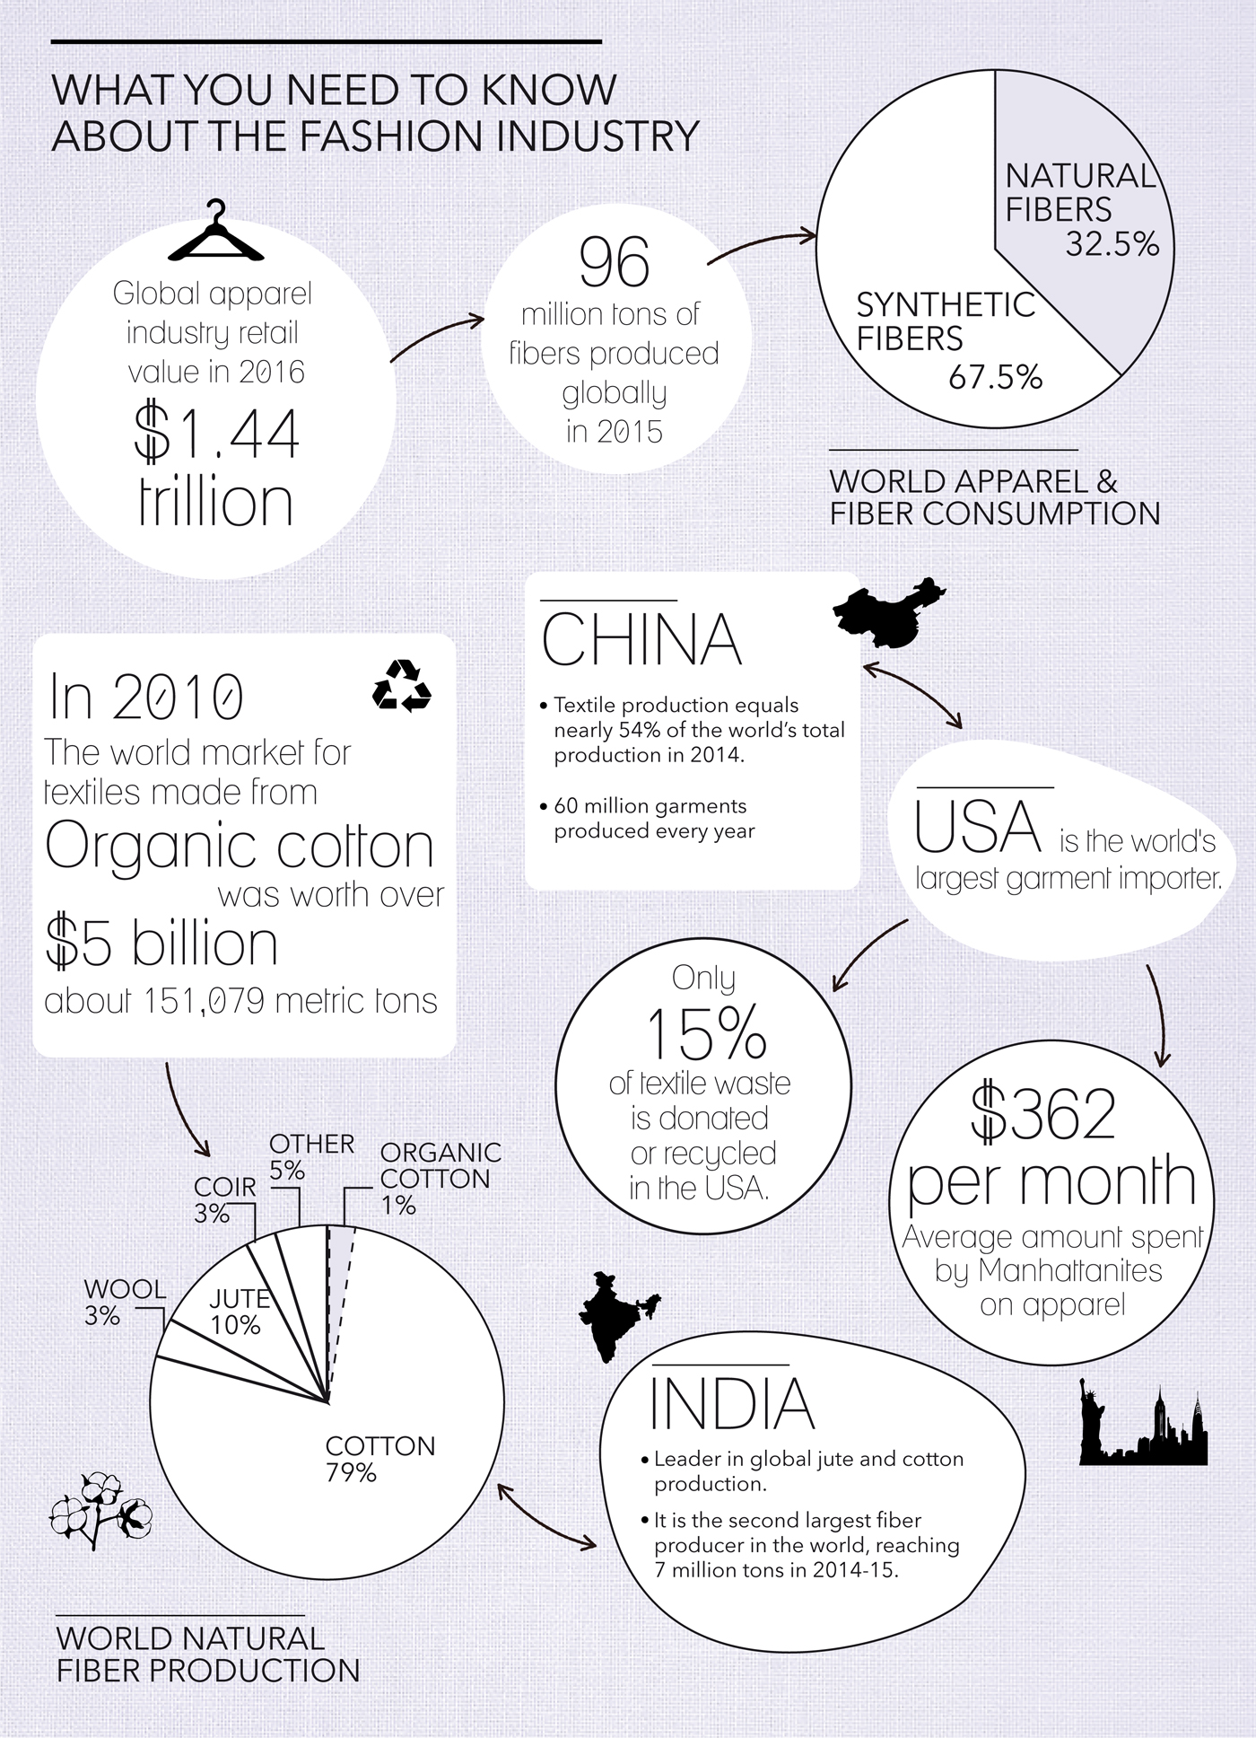
MTDI5002 Key Textile Technologies
The module is all about technologies used within and by the fashion and textile industries
New fibre developments
Construction- knitting and weaving
Colouration and finishing
Emerging technologies such as laser cutting and 3D printing to wearable electronics.
Introduces students to different technologies from the point of view of new innovation and sustainable practices.

Slide 4


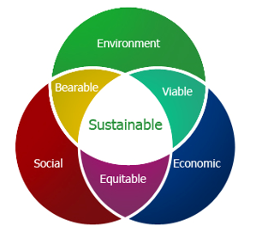
MTDI5001 Design, Innovation and Sustainability
Designed to introduce the complex issues surrounding sustainability and the role of design and innovation as a driver for change.
Students critically examine both the ethical and environmental impact of design and explore a variety of innovative materials and processes.
Environmental talks, past visits to waste management sites
Assessment –group and individual focusing on SDG’s and embedding environmental change into the supply chain

Slide 5
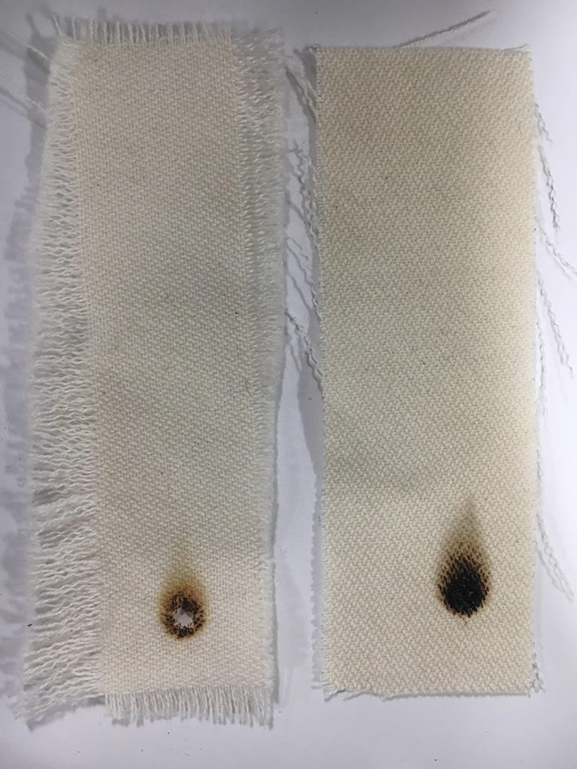
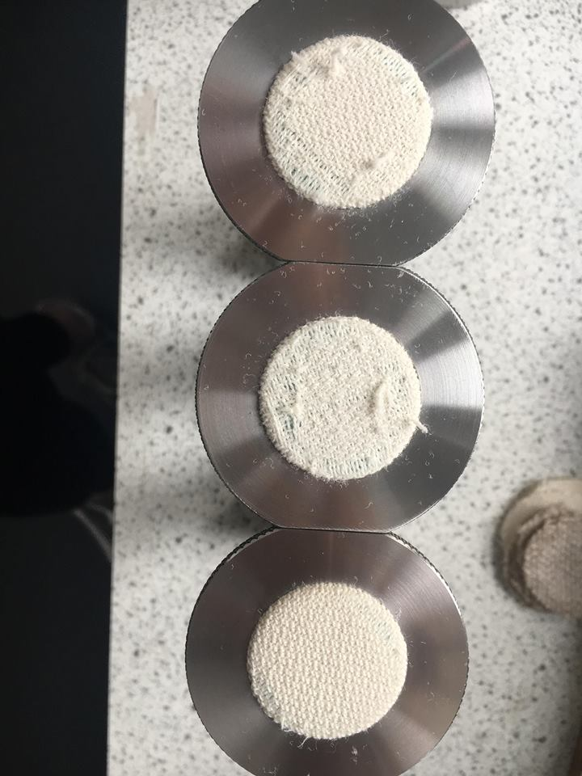
MTDI5003 Performance and Analysis
Understanding as to how material selection can influence the properties of a finished product and its fitness for purpose. We discuss materials to achieve performance but also their environmental impact.
Focus on product performance- quality considering test methods, user requirements, product longevity, and retailer expectations.
Previous student projects have focused on:
Sustainable DWP finishes for outdoor wear
Use and performance of natural fibres with inherent flammability properties
Clothing to enhance wellbeing for sports
Sustainable fibres for nightwear

Slide 6
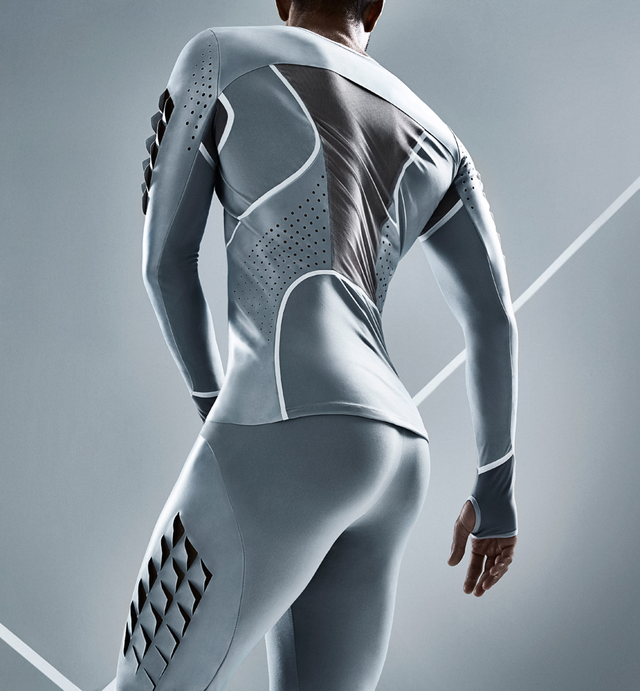
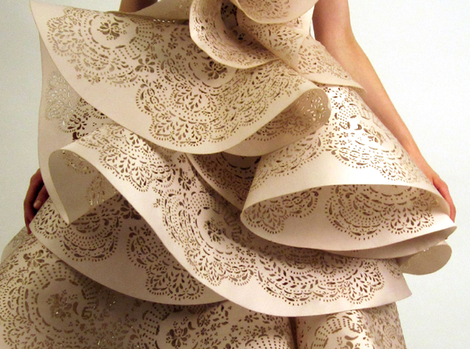
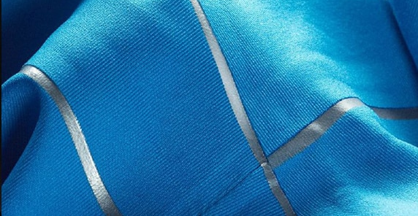
MDTI5004/5005 Manufacturing Processes and Technologies
5004- theory and 5005- practice
Identifying and comparing the most appropriate method of manufacture for a range of different material types and their function.
Understanding the strengths and weaknesses in types of manufacturing processes and suitability of methods for different textile products- consideration for environmental impact and ethical manufacturing
Formulating a proposal of manufacture for a selected textile product featuring innovative technologies and critical considerations for its implementation.
Previous student projects include;
Washable and reusable tapes rather than single use for longevity
Biodegradable sewing technology
Implementing new sustainable technologies and designing products for easier reuse and recycling

Slide 7
Final projects and next steps
Sustainability embedded all the way through the course:
Final projects include
Implementing biodegradable threads alongside sustainable fibres into a fashion supply chain
Durable sportwear
Sustainable sportswear offering compression (less elastane and synthetics use)
develop an enzyme catalysed dyeing process for protein fibres as an alternative to conventional coloration methods (sustainable colouration)
Next steps:
Tighten the sustainable design theme across core modules
Ensure sustained collaboration with industry to provide inspiration and project ideas
Live projects from industry

