Slide 1

Embedding Education for the SDGs – what this means, tools and support available
Dr Andrew Reeves, Institute of Energy and Sustainable Development
TeachSDGs event
Thursday 11th July 2019

Slide 2

Getting Started: the value in our work
What in your role or subject area makes you most proud in terms of its impacts for people or the world?
2 minutes
End
From De Montfort University (DMU) Strategic Framework 2015-2020
Notes:
Students discuss in pairs, then share ideas.

Slide 3
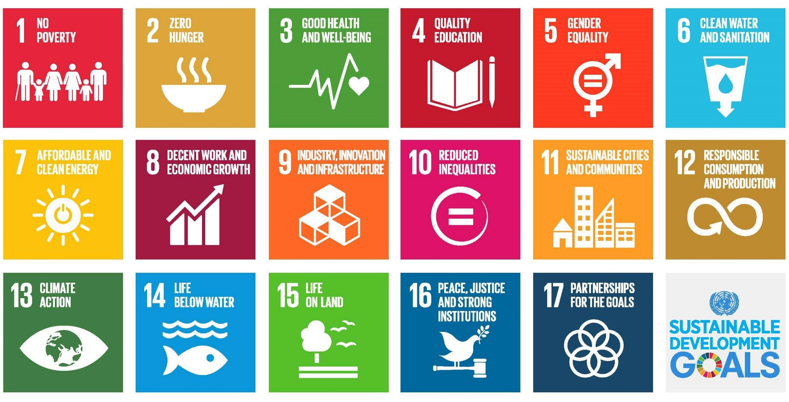
Achieving Public Good: Contributing to the UN Sustainable Development Goals
A transformative agenda for 2030
  Agreed via United Nations in September 2015

Slide 4

Not only 17 themes…
Holistically: “Sustainability is a dynamic process which enables all people to realise their potential and to improve their quality of life in ways that simultaneously protect and enhance the Earth's life support system” (Forum for the Future)
Specifically: 169 targets

Slide 5
Students and the University want greater engagement
82% of DMU students agree that sustainable development should be incorporated and promoted within all DMU courses
NUS Student Survey (2017)
“We will equip students and staff with an understanding of the challenges of sustainability and sustainable development, and will approach learning, teaching and assessment mindful of the opportunities to contribute locally and globally to the public good and environmental futures as well as of our impact on a resource-limited world.”
DMU University Learning Teaching and Assessment Strategy, 2018

Slide 6
Education for Sustainable Development
Aims to develop:
Knowledge and Understanding
Skills
Attributes
(QAA/HEA, 2014)
Skills such as:
collaborative working
systemic thinking
Leadership
Attributes such as:
critical thinking
flexibility
reflection
resourcefulness.
Learning about Sustainability
Learning in Sustainability
Learning for Sustainability
Deeper Engagement
Image based on Sterling (2001)

Slide 7
DMU ESD Project Aim
To enable and inspire students, staff and DMU’s wider community to collectively learn about and act on sustainable development and the SDGs, inspiring action now and in the future, professionally and through active citizenship.

Slide 8
Project Scope
Wider than DMU’s Taught Curriculum alone
Primary focus:
Taught and co-curriculum
Students and Staff
Supported by and supporting:
Sustainable Culture and Working Practices
Learning for sustainability in DMU’s wider communities
  in Leicester and around
  through national and international partnerships
DMU’s wider local and
global community
Culture and
Working Practices
Taught Curriculum
Co-Curriculum

Slide 9
Four Intended Project Outcomes
Knowledge: Awareness and understanding of sustainable development and the SDGs, applying these to disciplines, professions and citizenship.
Competencies: Ability to act for sustainable development, through ways of thinking and collaborative working, through citizenship and professionally.
Transformative Learning: Challenge unsustainable paradigms, critically reflect on experience and develop a personal commitment to sustainability.
Taking Action: Enable individuals and teams to act to support sustainable development and prevent unsustainable practices, at DMU and in the community.

Slide 10
Implications for a Programme?
Consider aiming for at least
  Introducing Sustainable Development
  Awareness and relevance of the SDGs
  Linked to at least one assessment
  Done by all students
    Compulsory module(s)

Slide 11
Practical Ideas
Assessment
Thinking Tools
Case Studies
Pedagogy
Useful Resources
Learning Outcomes
Introducing SD

Slide 12
Assessment
Make a sustainable development challenge or an SDG the focus for an assessed activity
  Offer and/or students choose
Done at DMU in Social Enterprise, Marketing, Electronic Engineering…

Slide 13
Embed in Course Learning Outcomes
Align with professional bodies?
Link to ESD project outcomes
Draw on published LOs linked to each SDG

Slide 14
Useful Resources
Commonwealth Curriculum Framework for the SDGs (2017). Detailed guidance on developing taught courses to address the SDGs (both holistically and individually), aiming to transform: knowledge and understanding; skills and applications; values and attitudes.
Education for Sustainable Development Goals: Learning Objectives (2017). UNESCO guidance on developing teaching and learning to address the SDGs.

Slide 15
1. Knowledge of Sustainable Development
Awareness and understanding of the SDGs and sustainable development, applying these to disciplines, professions and citizenship
DMU’s students, staff and community stakeholders are:
  aware of the UN Sustainable Development Goals
  able to confidently explain what ‘sustainable development’ means, in general and linked to their discipline/profession and role as a citizen
  able to analyse and discuss at least one contemporary sustainable development challenge, including its causes, effects and potential strategies to address it

Slide 16
2. Developing Competencies
Ability to act for sustainable development, through ways of thinking and collaborative working, through citizenship and professionally.
DMU’s students, staff and community stakeholders are:
  able to see issues in a wider context, thinking systemically and in terms of possible futures
  able to work collaboratively to address sustainable development challenges
  able to analyse and discuss at least one contemporary sustainable development challenge, including its causes, effects and potential strategies to address it

Slide 17
3. Transformative Learning
Challenge unsustainable paradigms, critically reflect on experience and develop a personal commitment to sustainability
DMU’s students, staff and community stakeholders are:
  able to critically analyse societal issues
  able to describe a paradigm that challenges Business as Usual linked to a particular subject area or sustainability issue
  able to demonstrate commitment to achieving sustainable development through a paradigm applied to a subject or issue

Slide 18
4. Taking Action
Enable individuals and teams to act to support sustainable development and prevent unsustainable practices, at DMU and in the community
DMU’s students, staff and community stakeholders have:
  taken part in events or initiatives that addresses one of the SDGs or a sustainable development issue
  planned and implemented a project addressing the SDGs or a sustainable development issue, either individually or as part of a team

Slide 19
Introducing Sustainability
Some principles
  Allow for discussion
  Put in context, linked to discipline or real problems

Slide 20
1: Offer several definitions
Which do you prefer? Which is most relevant to your discipline?
“Sustainable development is the kind of development that meets the needs of the present without compromising the ability of future generations to meet their own needs.” Bruntland Commission
Sustainable development is about “living within our means”
“Sustainable development is about “ensuring that no one is left behind.” UN
“Sustainable development – a dynamic process that enables all people to realise their potential and to improve their quality of life in ways which simultaneously protect and enhance the Earth’s life support systems.” Forum for the Future
“To achieve sustainability we must balance economic, environmental and social factors in equal harmony”

Slide 21
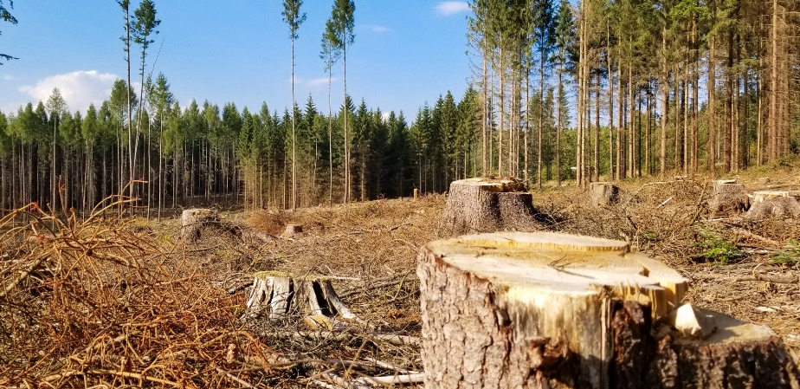
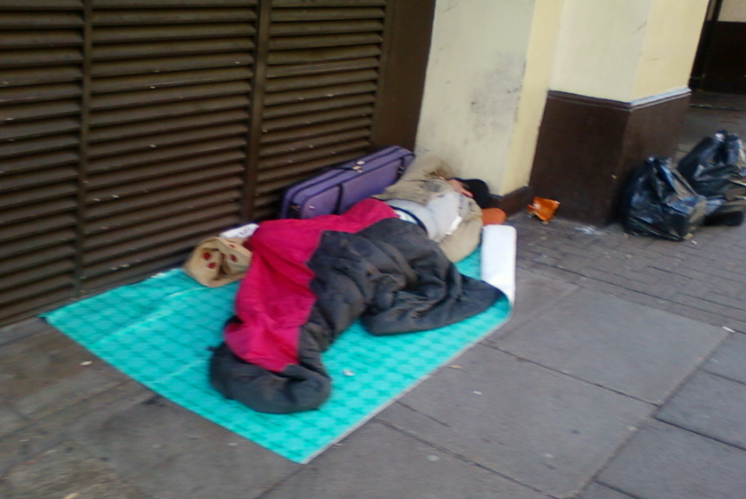
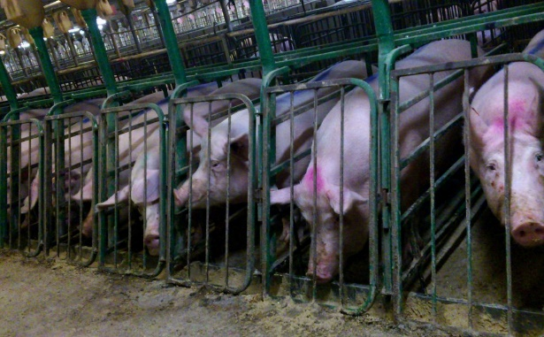
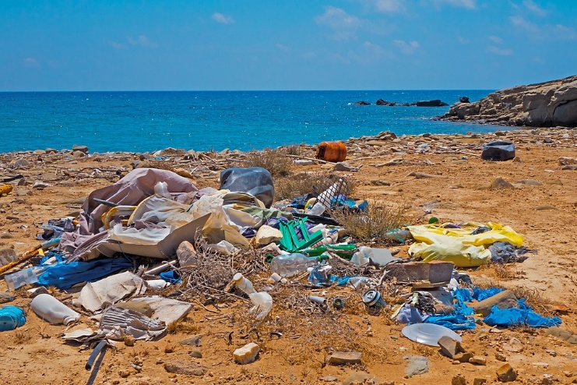
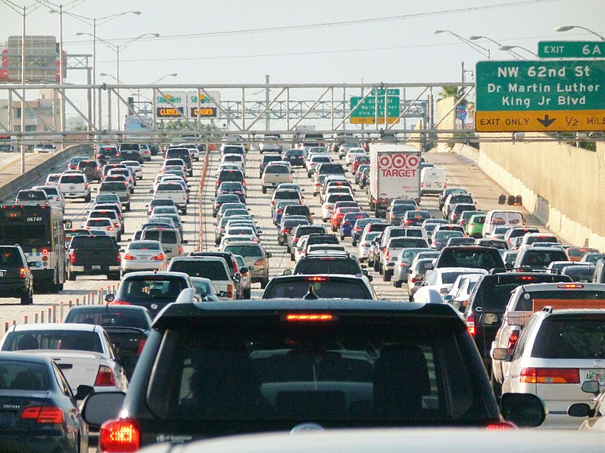
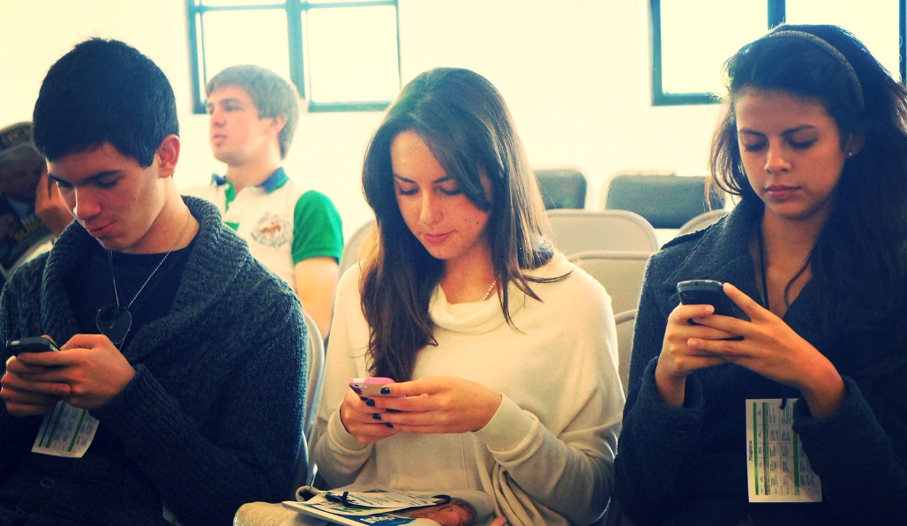
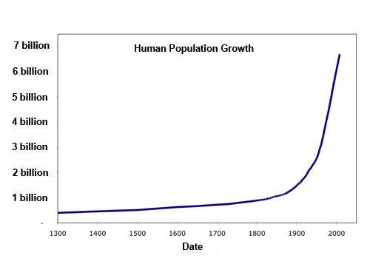
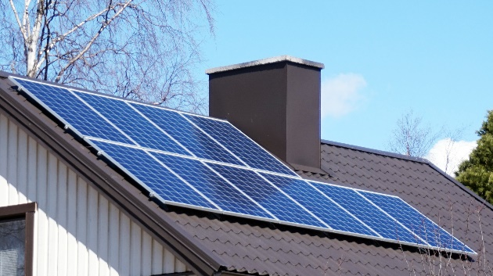
2: Share a printout of pictures
In small groups
  “Is this sustainable? Why?”
  Aim for some more ‘obvious’ yes/no, some that might trigger debate
Notes:
https://www.publicdomainpictures.net/en/view-image.php?image=296125&picture=deforestation
https://commons.wikimedia.org/wiki/File:Miami_traffic_jam,_I-95_North_rush_hour.jpg
https://kivu.com/human-population-increase-how-are-we-doing/
https://pixabay.com/photos/garbage-plastic-waste-beach-3552363/
https://www.flickr.com/photos/50999011@N08/4944446927
https://www.flickr.com/photos/mercyforanimalscanada/8250115715
https://www.flickr.com/photos/esthervargasc/9657863733
https://commons.wikimedia.org/wiki/File:Jyv%C3%A4skyl%C3%A4_-_solar_panels.jpg

Slide 22
3: Ask a question before giving any definitions
“What sustains you?”
“What do you think sustainability means?”
“What do the 17 sustainable development goals have in common?”
Allow for subsequent discussion

Slide 23

4: Discuss the SDGs
“Which is most important? Why?”
“Which is most relevant to your course? Why?”
Pick an SDG: “Does it rely on any other SDGs to be achieved? What social practices or technologies can make it possible to achieve it?”
Learning: critical thinking; systems thinking; futures thinking

Slide 24
Thinking Tools

Slide 25
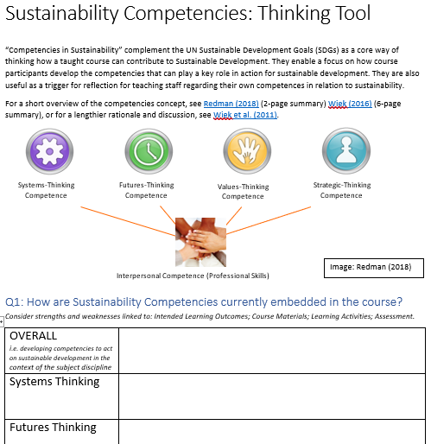
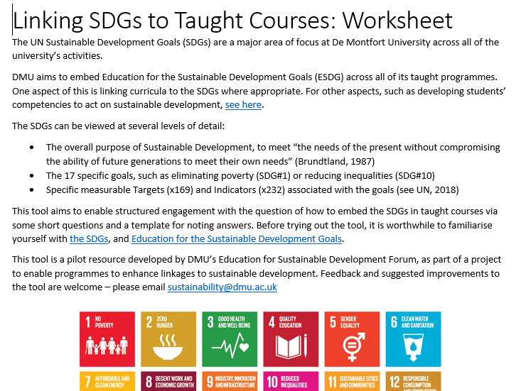
Thinking Tools
SDGs
Sustainability Competencies
  See Wiek et al., Engle et al., UNESCO Global Action Plan
Consider key parts of course
  Learning Outcomes; assessment; Activities & Materials

Slide 26
Ten Steps
“Ten Steps towards Education for the SDGs” – one sheet of A4/A3
  Ten potential actions rated (0 not done; ½ partially; 1 strongly)
  Leads to identification of good practice and enhancements
Next step: Ten Ingredients, aligned to ESD project Outcomes
Step | Action
1 | Students develop critical thinking skills
2 | Development of interpersonal working skills
3 | Key concepts of sustainable development are introduced
4 | SDGs addressed via topics covered, either implicitly or explicitly
5 | Key course concepts are put in a wider social or historical context
6 | Ethics and values are linked to the activities taught in the course
7 | Minimising resource use and negative social or environmental impacts
8 | Students learn via engaging with real-world sustainability challenges
9 | Inspiration- students encounter inspiring examples of how their discipline can address sustainability
10 | SDGs or sustainable development in course learning outcomes
COMPETENCIES
KNOWLEDGE
TRANSFORMATION
TAKING ACTION

Slide 27
Give it a go
0 =not done; ½ = partially; 1 = done strongly
Step | Action
1 | Students develop critical thinking skills
2 | Development of interpersonal working skills
3 | Key concepts of sustainable development are introduced
4 | SDGs addressed via topics covered, either implicitly or explicitly
5 | Key course concepts are put in a wider social or historical context
6 | Ethics and values are linked to the activities taught in the course
7 | Minimising resource use and negative social or environmental impacts
8 | Students learn via engaging with real-world sustainability challenges
9 | Students encounter inspiring examples of how their discipline can address sustainability
10 | SDGs or sustainable development in course learning outcomes

Slide 28
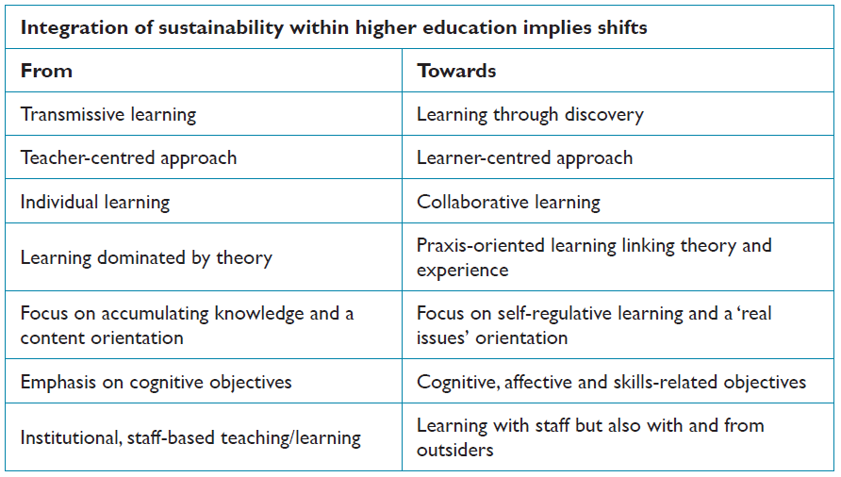
How to do ESD? Pedagogic Approaches
From Sterling (2012), based on Van den Bor et al. 2000

Slide 29
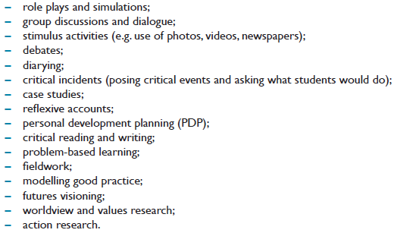
How to do ESD? Specific Techniques
From Sterling (2012, pg.38), adapted from Cotton and Winter (2010)

Slide 30
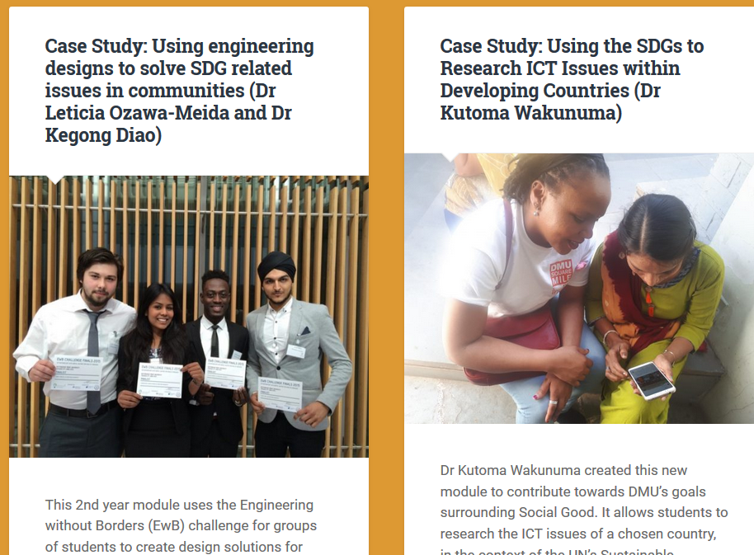
Case Studies
Posted on https://esdg.our.dmu.ac.uk
Examples linked to the intended ESD outcomes

Slide 31
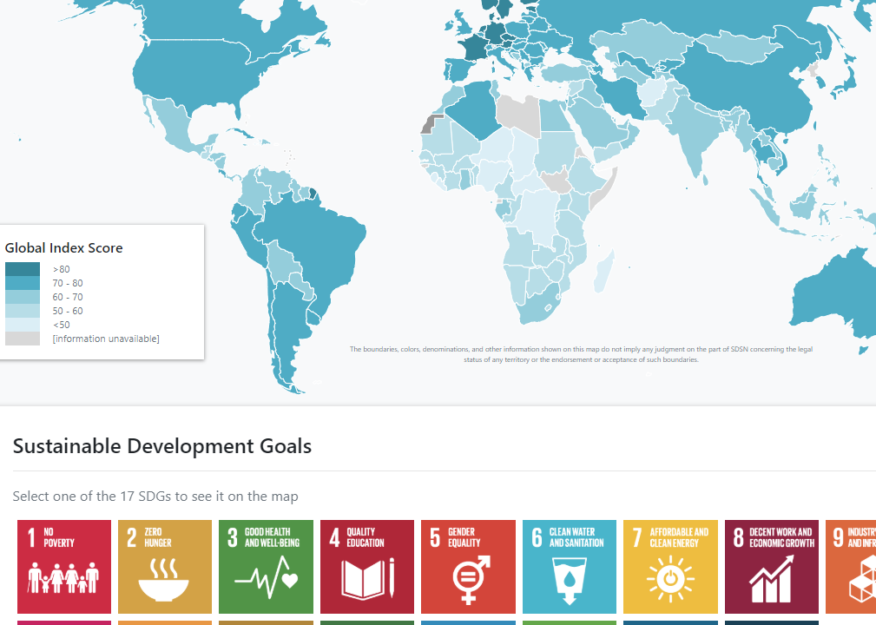
Useful Resources
https://esdg.our.dmu.ac.uk/teaching-resources/learning-materials/
Including:
  Data on SDG progress by goal and country
  Learning materials for a range of subjects
https://dashboards.sdgindex.org/#/

Slide 32
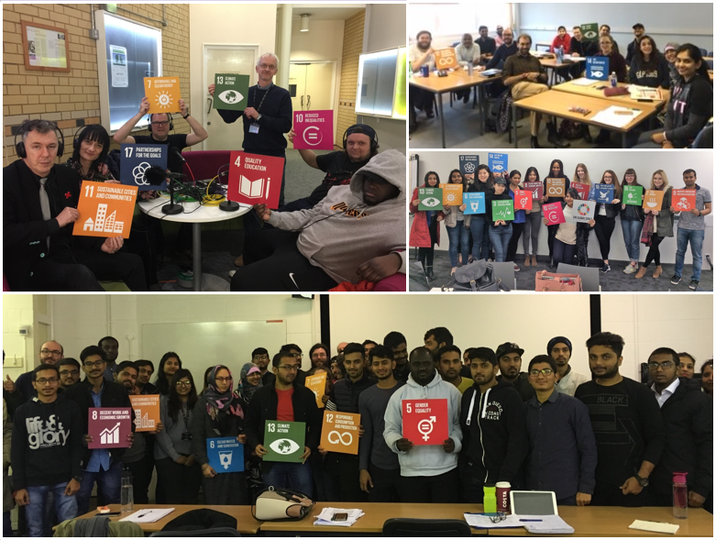
Next Steps
SDG Teach-in: Feb 17th to 21st 2020
  Include SDGs in teaching that week
  Potential event in Oct/Nov
ESD Forum
  Email list; quarterly meeting
  Faculty ESD Forums?
Follow ‘SustainableDMU’ on Facebook and Twitter

Slide 33
Q&A and Feedback
Contact: areeves@dmu.ac.uk

