Slide 1
#rsaleicestershire
Fashion: Designing a Circular Economy
@theRSAorg
@RSADesignAwards
@josie_warden

Slide 2
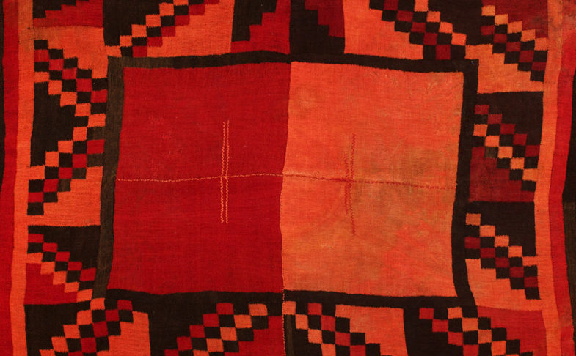
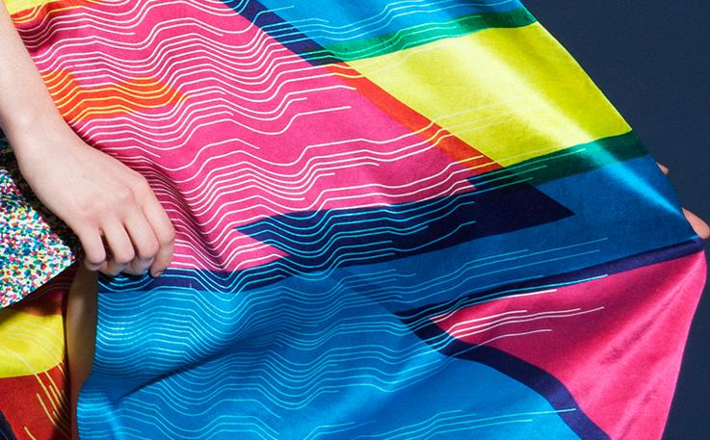

Slide 3
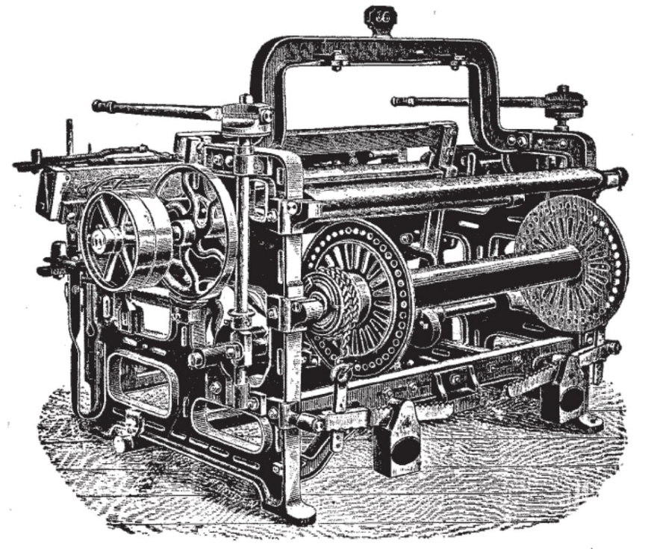
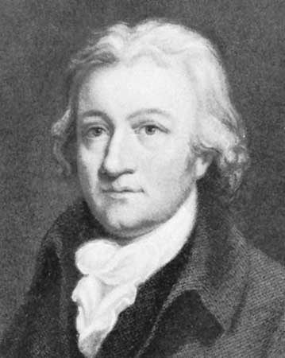

Slide 5
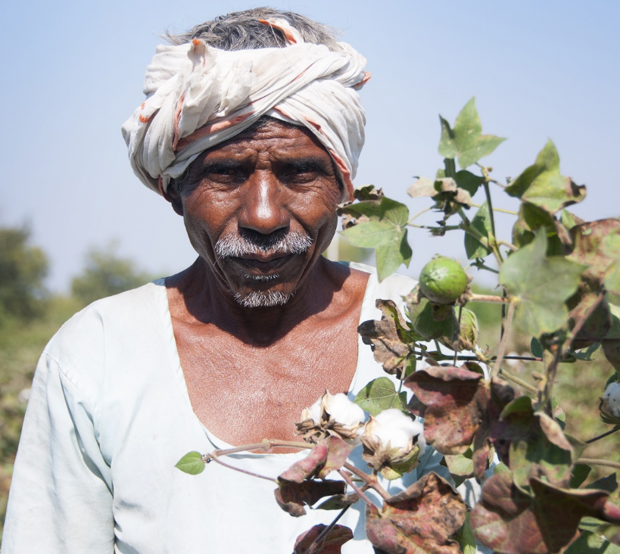
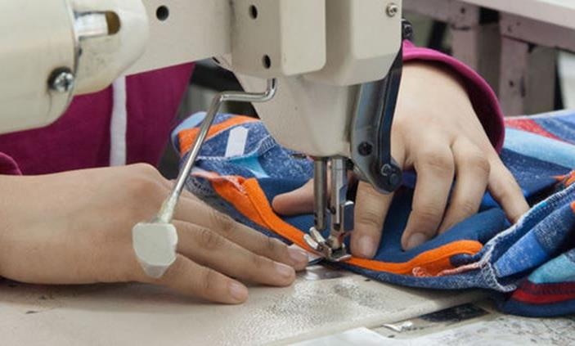

Slide 6
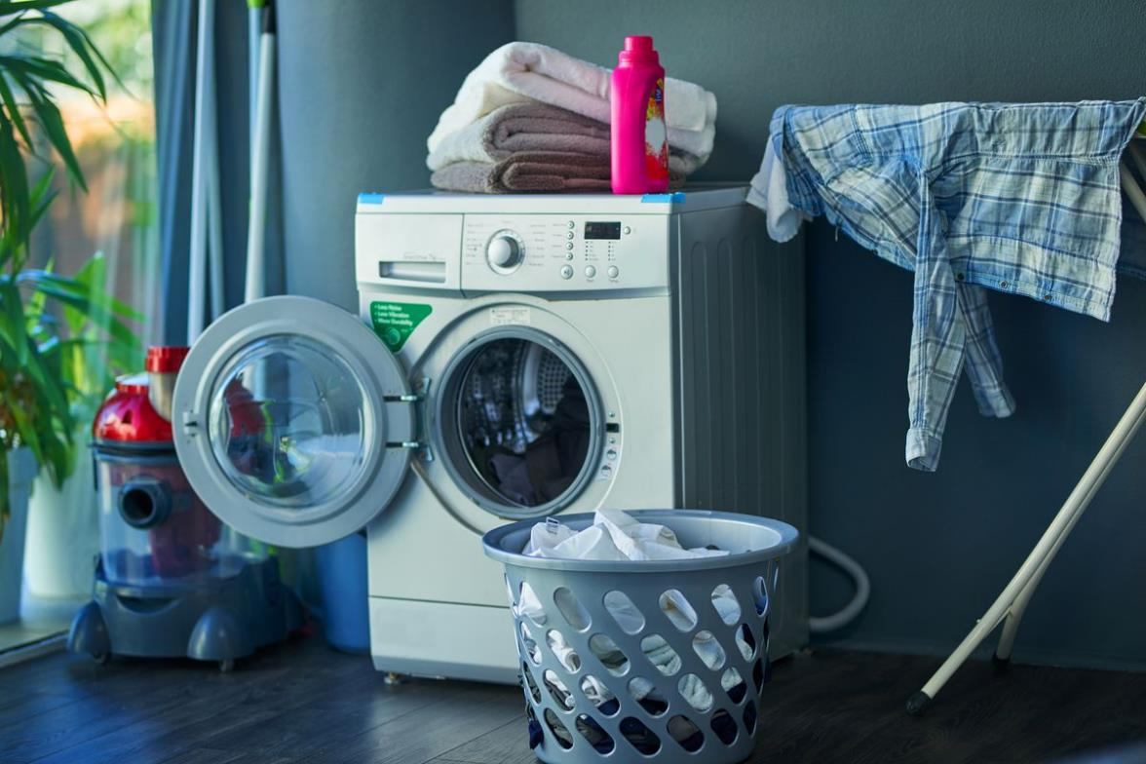

Slide 7
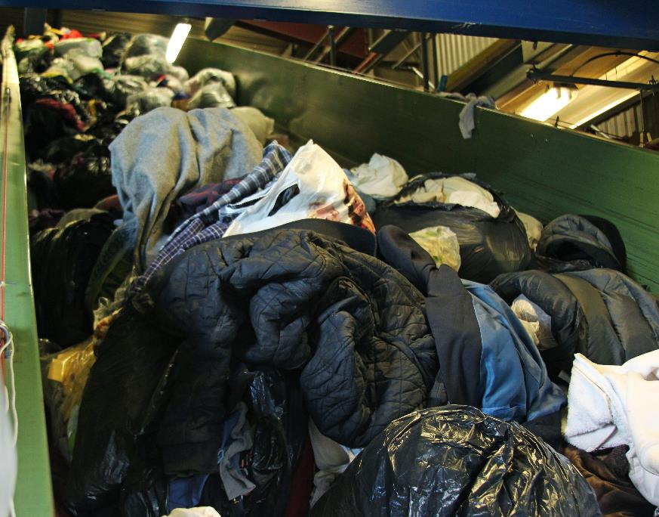
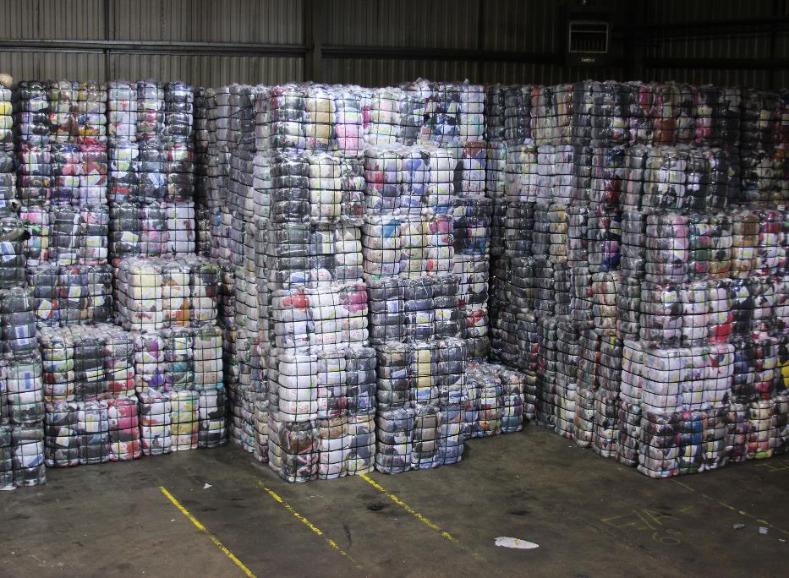
RSA Great Recovery

Slide 8
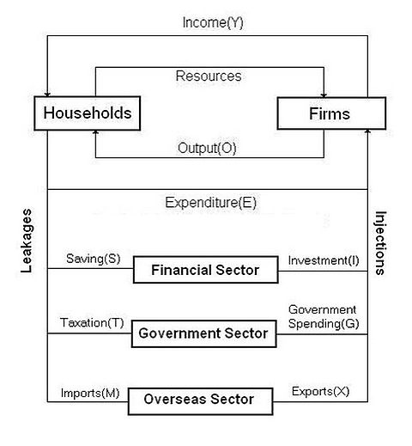

Slide 10
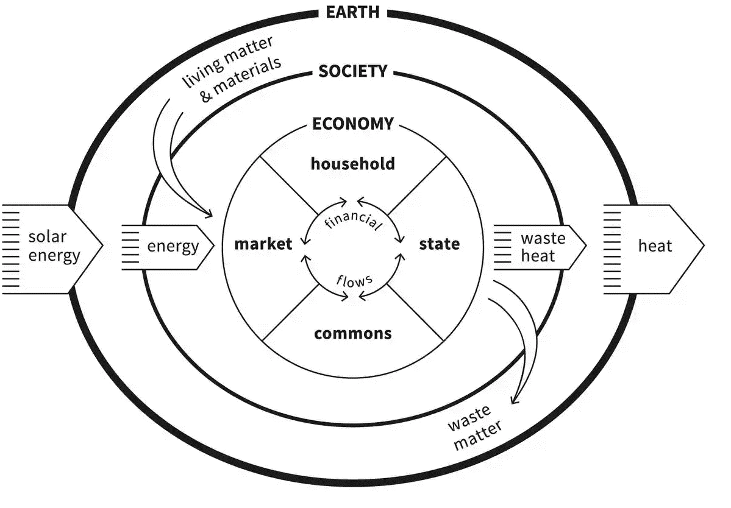

Slide 11
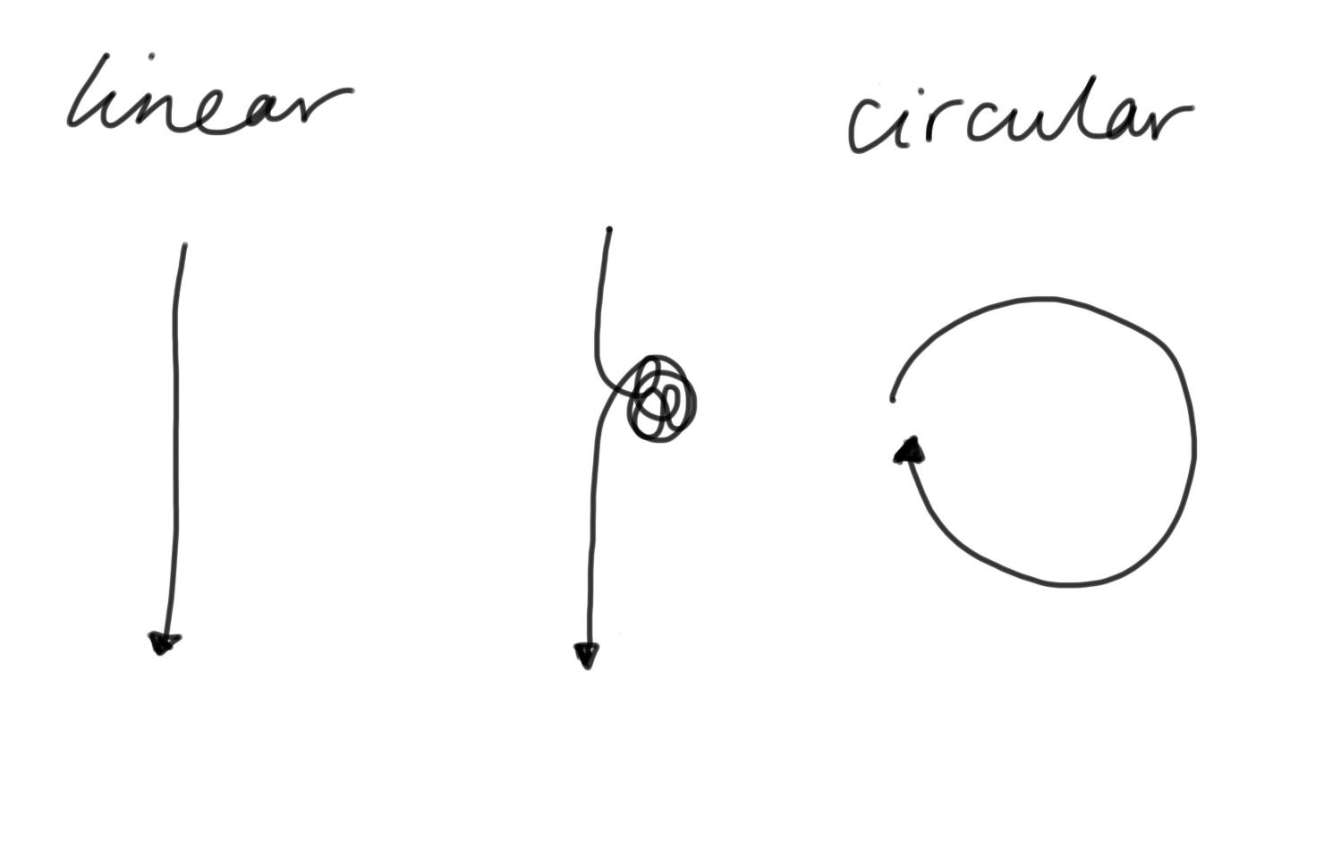

Slide 12
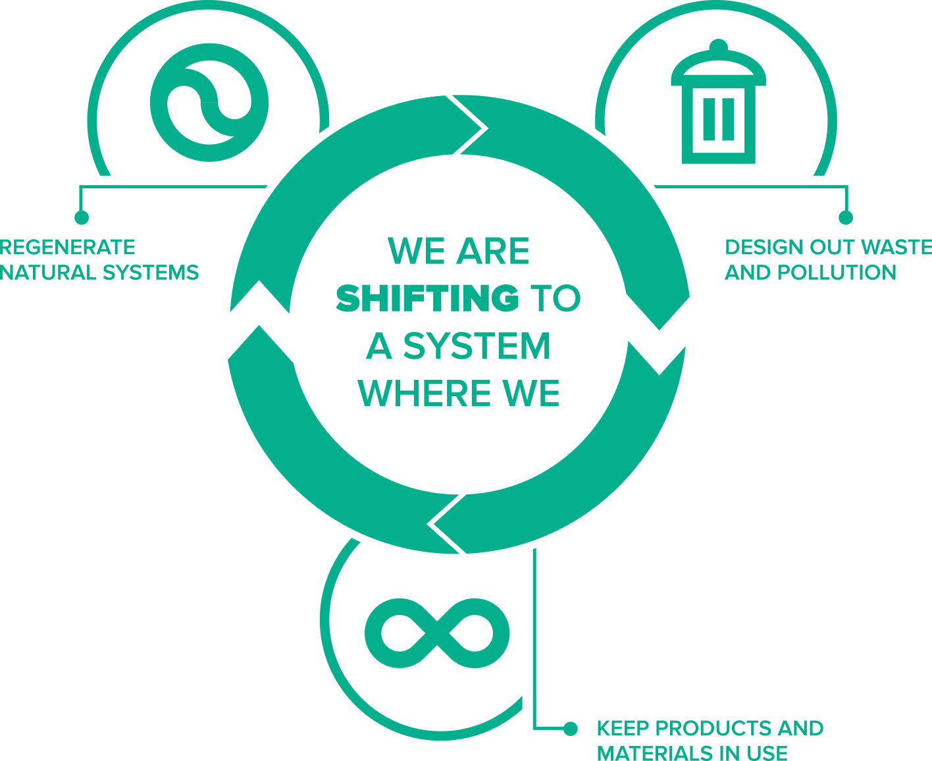

Slide 13
1. Keeping clothes in use for longer
2. Safe and renewable materials
3. Designing for recyclability

Slide 14
Charles Eames:
“What are the boundaries of design?”
Design
“What are the boundaries of problems?”

Slide 15
Design:
Ask the right question
Involve the right people
Test and evaluate
Iterate

Slide 16
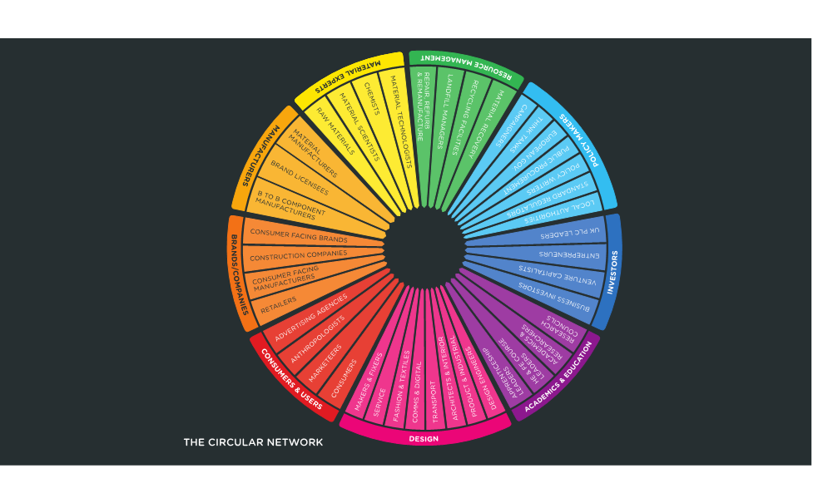

Slide 17
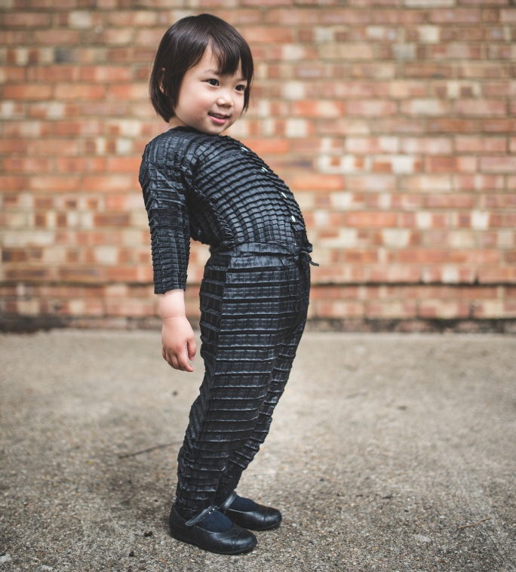
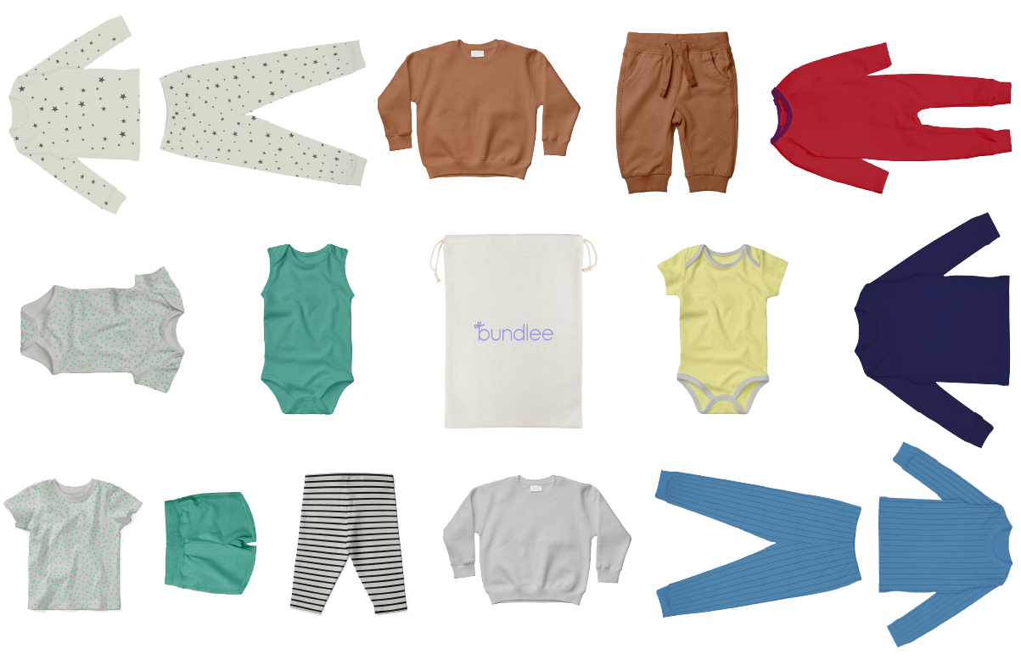

Slide 19
2018/19 Briefs
Make Fashion Circular
How might we use circular design principles to innovate the way we produce, use and access everyday clothing items?
Award:
PPL Dream Fund Award of £2,000

Slide 20
Year 2: 2020/21
Innovation Cohort
Building a field of young designers working on circular economy in fashion to increase collective impact

Slide 21
#rsaleicestershire
Thank you

