Slide 1
In the news recently...
Notes:
Optional intro: Copy an image of a recent news headline here that links to sustainable development and the programme. This might be news about a problem or challenge, or knowledge from the field being used to come up with a solution.
Ask: Did anyone see this story? (use online poll: yes/no) And then discuss its relevance

Slide 2
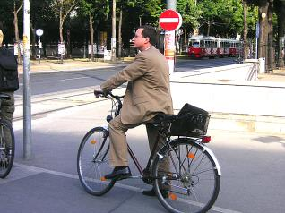
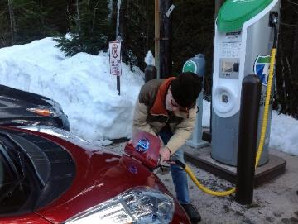
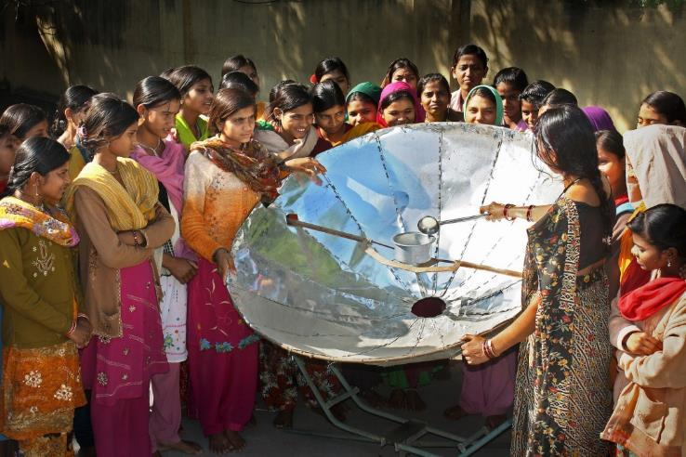
Is it “sustainable”?
Images from Climate Visuals
“Sustainable development is the kind of development that meets the needs of the present without compromising the ability of future generations to meet their own needs.”
Bruntland Commission, 1987
Notes:
Ask for one or two views on what it means for something to be “sustainable” (hands-up or in chat window)
Then share the definition, and highlight that it relates to meeting society’s needs now and for the long-term. (Images are cycling in a city; recharging an electric car; using a solar cooker.)
Provide or ask for an example or two of “sustainable” related to the course. For example – in architecture this might be about choice of building materials; in education this might be about tackling unequal access to learning.

Slide 3
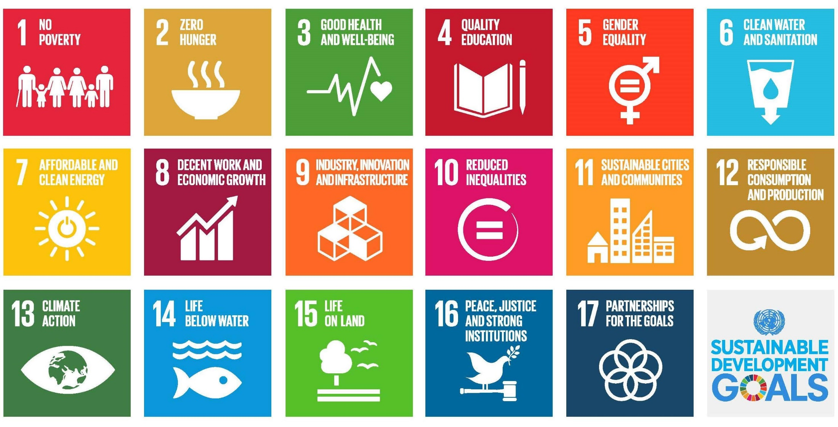
The UN Sustainable Development Goals
Agreed by United Nations in September 2015 – ambitious targets for 2030
DMU is committed to addressing them through teaching and research
Which are most linked to your course?
Notes:
Introduce the UN SDGs as one way of thinking about what sustainable development aims to achieve. Note examples of what they cover – social issues (eradicating poverty and hunger, challenging inquality); economic prosperity (e.g. decent work) and caring for life on earth (e.g. climate action; life below water)
Ask the class – which goal is most relevant for the course and why? (Online: in chat window. In large in-person groups, pair discussion for 1 minute prior to sharing)
Ask the class – for a strongly relevant goal, does it rely on other goals to be achieved? (This can be used to highlight how they are often interconnected, and achieving them is not straightforward). If online, in chat, or hands-up to speak.
Summarise: These issues represent many of the major challenges in society, and our education can help us address them.

Slide 4
How can you make a difference at DMU?
DMU Local:
Volunteer in the local community https://www.dmu.ac.uk/community/public-engagement/index.aspx
Share your ideas for action: DSU Ideas Hub: https://www.demontfortsu.com/voice/campaigns/ideashub/
Carbon Literacy Training:
Understand and act on climate change
https://esdg.our.dmu.ac.uk/projects/carbon-literacy/
DMU Sustainability Team
Follow on social media for events and volunteering
https://www.dmu.ac.uk/about-dmu/sustainability/sustainability.aspx
De Montfort Students’ Union: Societies and Volunteering https://www.demontfortsu.com/activities/volunteering/
https://www.demontfortsu.com/activities/societies/
Notes:
Signpost links to DMU wide opportunities
As appropriate, discuss opportunities to make the links within the course – e.g. choice of project, dissertation, trips, etc.

Slide 5
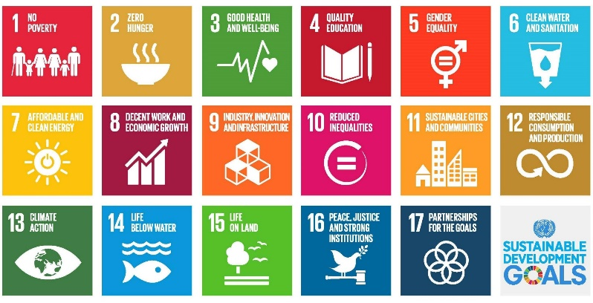
The SDG Teach-in
A UK-wide event, February 22nd to March 5th 2021
Organised by SOS-UK, part of National Union of Students
Responding to student demand
Thank you for taking part!
Notes:
Highlight that this is part of a national event led by SOS-UK
They organise many projects focussed on sustainability, based upon strong levels of interest from their members

