Slide 1

Making the Links:
De Montfort University and the UN Sustainable Development Goals
Part of the SDG Teach-in at DMU
February 22nd to March 5th 2021.
Notes:
Contact Andrew Reeves (areeves@dmu.ac.uk) for any questions around developing a session using these slides.
Andrew can also potentially join sessions to co-deliver these materials.

Slide 2

Aims for the Activity
Introduce the SDGs
  DMU’s commitment
  Links to your course
How you can contribute
  Via your course
  Via volunteering, societies and more

Slide 3
The Big Picture: What is a university for?
Notes:
5-minute activity:
Part 1:
Put the question to students (not revealing next slide) and either:
A: Invite students to do a ‘word shower’ in the chat window… type response and then when you say “go” hit return so responses arrive in the chat window.
B: Use online voting (e.g. PollEverywhere, sli.do) to make a wordcloud of responses (suggest short 1-2 word responses). (Andrew Reeves can share sli.do resources – areeves@dmu.ac.uk)
C: In a face-to-face session, either students discuss in pairs or small groups for 2-4 mins, then elicit their ideas or elicit ideas from individuals without prior discussion
Session leader then notes the main themes of responses

Slide 4

The Big Picture: What is a university for?
Notes:
Part 2: Show the slide with DMU’s Mission – note what this has in common with responses elicited, and how it differs
Highlight that the purpose of DMU goes far beyond teaching students, and aims to create a positive impact in the world

Slide 5

Achieving Public Good: Contributing to the UN Sustainable Development Goals
A transformative agenda for 2030
  Agreed via United Nations in September 2015
  A focus for all activity at DMU – study, research and more
Notes:
Briefly introduce the UN SDGs as a framework to understand how DMU makes its contribution to the ‘Public Good’

Slide 6
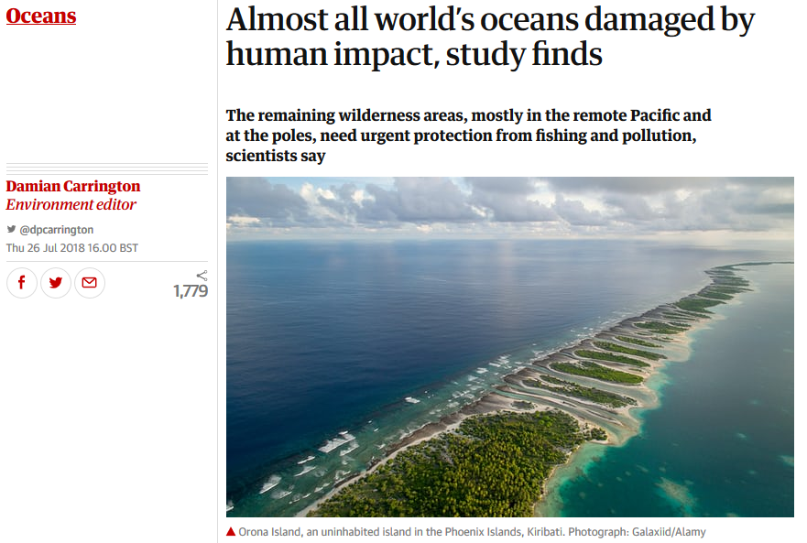

(Always) a topical issue!
From the Guardian:
https://www.theguardian.com/environment/2018/jul/26/just-13-of-global-oceans-undamaged-by-humanity-research-reveals
Notes:
Optional slide: Replace the news story image and the SDG image (available here https://www.un.org/sustainabledevelopment/news/communications-material/) with a topical news story linked to the SDGs, if possible, linked to the course being taught

Slide 7
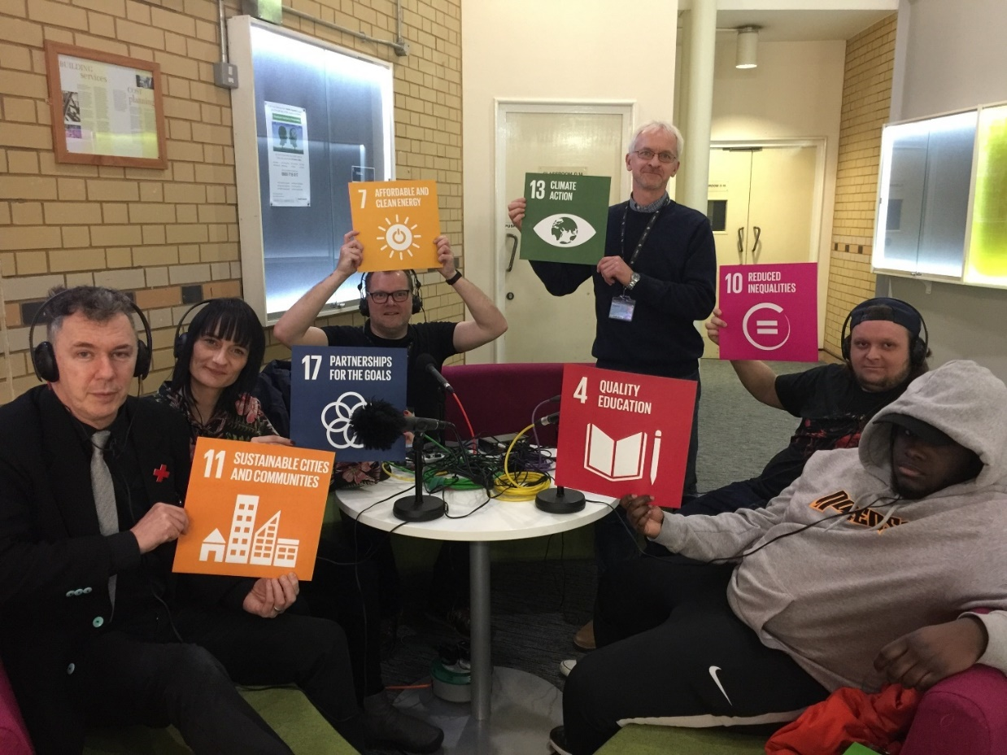
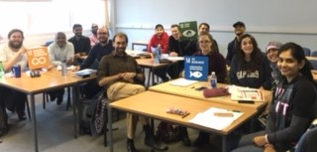
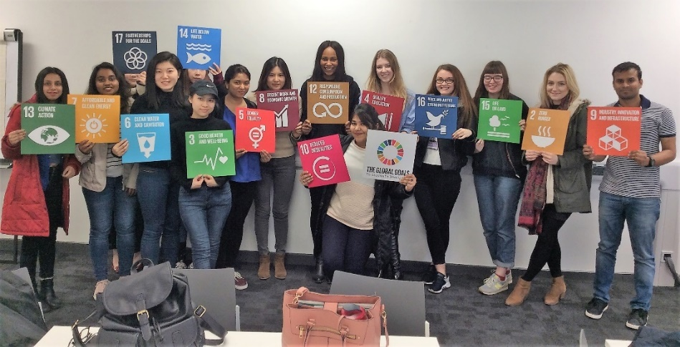
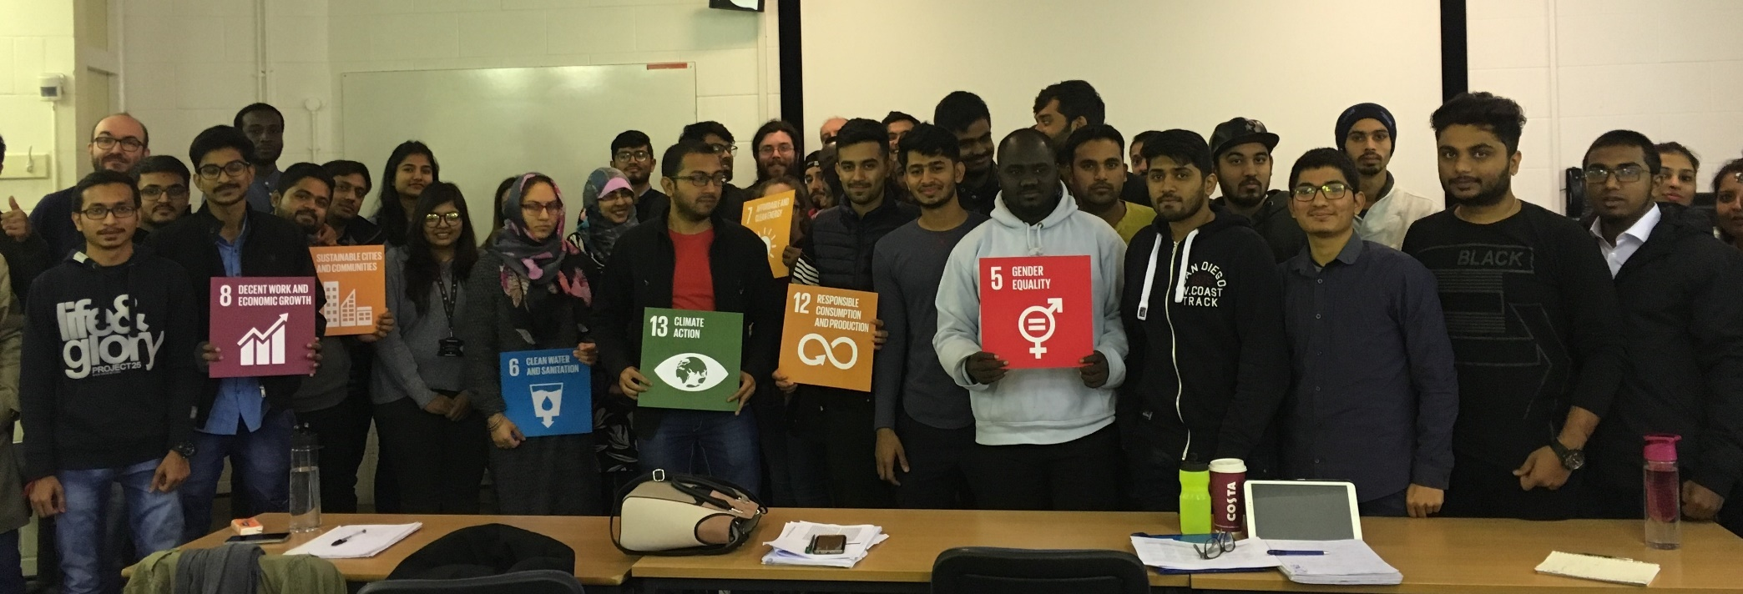
SDG Teach-in: Feb 22-26 2021
Photos from DMU SDG Teach-in, February 2018
Notes:
Optional background:
The SDG Teach-in is organised by the SOS-UK (Students Organising for Sustainability, UK)
Universities across the world are invited to take part, by linking the SDGs to sessions that week
DMU has been in the top-5 UK universities by staff participation since 2018

Slide 8
This is important to DMU and its students!
82% of DMU students agree that sustainable development should be incorporated and promoted within all DMU courses
NUS Student Survey (2017)
“We will equip students and staff with an understanding of the challenges of sustainability and sustainable development, and will approach learning, teaching and assessment mindful of the opportunities to contribute locally and globally to the public good and environmental futures as well as of our impact on a resource-limited world.”
DMU University Learning Teaching and Assessment Strategy, 2018
Notes:
Optional slide with background info:
Results from an annual NUS survey on student attitudes to sustainability
Quote from DMU’s teaching and learning strategy, stating our commitment.

Slide 9

Discussion 1
Which goal(s) are most urgent or important where you grew up (whether UK or overseas)?
Notes:
Aim: to prompt awareness of the range of goals and critical reflection on strategies for achieving them
Part one: Put the question to the group.
Students engage as per slide 3 (use chat window; use online/text vote or poll; or if face-to-face, through pair discussion then feedback). Ask students to consider why or further elaborate their responses. Seek to draw out any general conclusions, or differences between the SDGs in different contexts.
Part two: Further questions to elicit further reflection on the goals. For example:
Which goal(s) are most challenging to achieve? Why?
Which goal do you see as having most support or most grounds for hope? Why?

Slide 10
Discussion 2
Which goal do you think is most strongly connected to your course?
Notes:
AIM: Encourage students to consider relevance of SDGs for their study, and inter-relationships between goals
Part One:
Elicit student’s views on the goal with the strongest link (as per slide 3, this could be via chat window, online/text vote or pair discussion if face to face)
Summarise the views of the group
Part Two:
Note the most popular SDG, and ask students to consider if its achievement relies on other goals being achieved. Prompt: which goals and why?

Slide 11
Get involved at DMU
Follow #SustainableDMU on social media for latest news on events and volunteering opportunities
Also look up…
#DMULocal – volunteer in the local community
#DMUGlobal – support sustainability through an inspiring study trip (online or in-person)
DSU Ideas Hub: put forward an idea, gain 15 likes and gain support from DSU
DSU Student Societies: several societies focus on social/environmental issues, such as “Enactus” and “Go Eco”

