Slide 1
Real-Life Learning and Education 2030
Andrew Reeves and Sunita Patel
13th January 2022
Notes:
What is it? Why does it matter?

Slide 2
Agenda
Introduction: Real-Life Learning and links to Education 2030
Examples of Practice
Exploring opportunities and challenges

Slide 3
Exploring our link to the topic
Consider
A: A subject/field you teach
B: Some of the key non-academic stakeholders in the local/wider community beyond DMU who have an interest in the issues taught

Slide 4
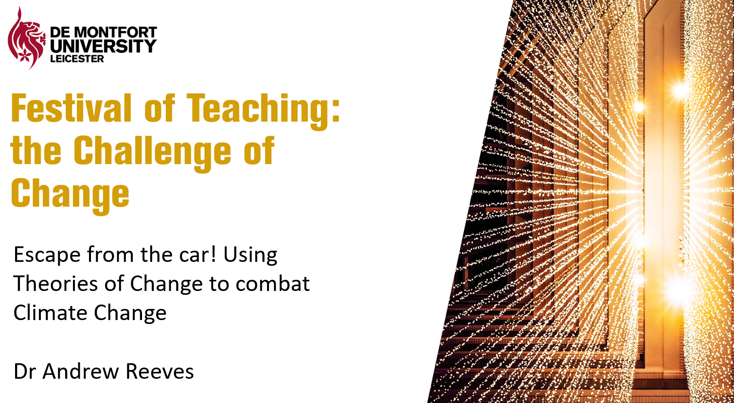
An Example: Masters
Module: ‘Leading Change for Sustainability’ (from MSc Energy and Sustainable Development)
Examples of practice:
Live Briefs within module
Sustainabilty at DMU; eBikes in Leicester
Personal behaviour change action learning
Internalises learning, develops worldview
Training on behaviour change and climate communication
Local charities, East Mids councillors, local government officers
Festival of Teaching: Escape from the Car
How might this apply in your own context?

Slide 5
A working definition
“Real-Life Learning at DMU integrates real-world experiences, community contribution and a focus on sustainability challenges into student’s learning. This creates mutual benefit – for students’ learning and wider society.”

Slide 6
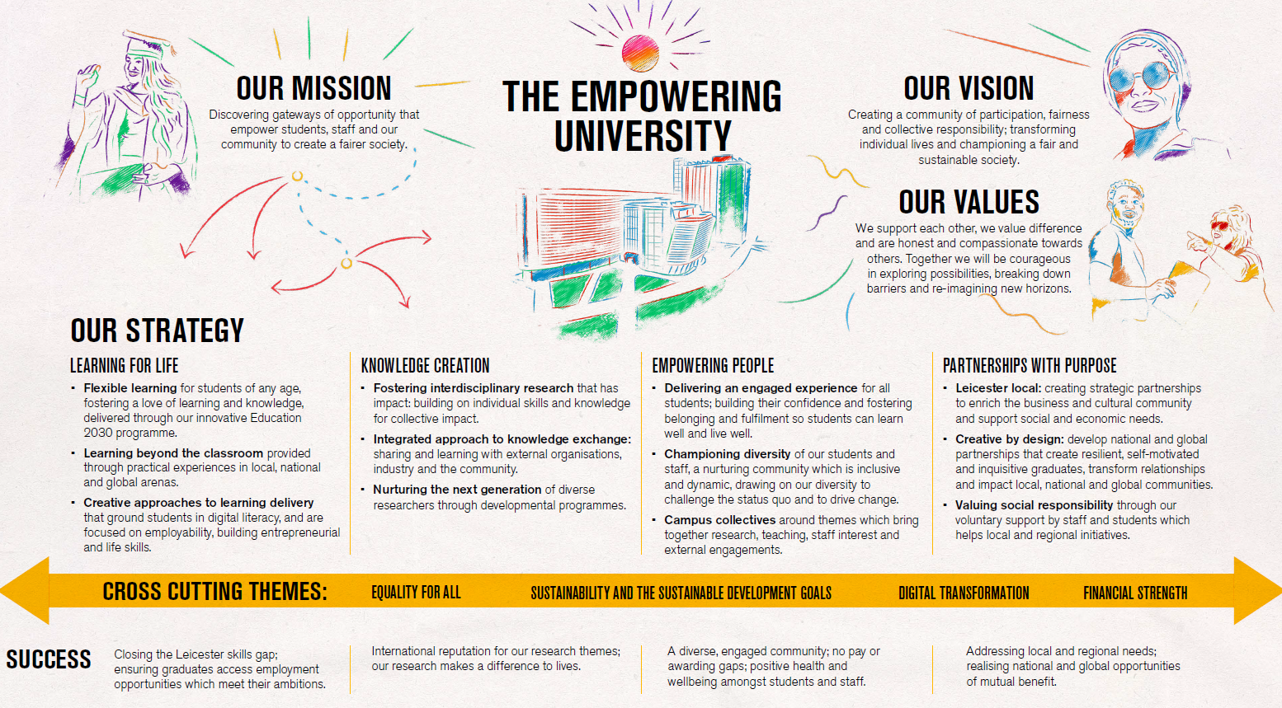
Fit with new DMU strategy

Slide 7
Fit with new DMU strategy

Slide 8
Four approaches to Real-Life engagement
DIRECT COMMUNITY BENEFIT
DMU Real-Life Learning
1: 'Case Study' Learning
(Learning but no action beyond DMU; no immediate wider community benefit - e.g. projects on Live Briefs, simulations in class)
2: Community Service
(Action for direct Community Benefit - e.g. volunteering)
3: Transformative Learning
(Learning but not action; indirect wider community benefit e.g. DecolonisingDMU)
4: Service Learning
(Action for direct Community Benefit and transformative learning - e.g. volunteering and critical reflection)
INDIRECT COMMUNITY BENEFIT
Notes:
PULL onto the grid: need for better engagement/relevance/employability
PULL to the right – chance to ‘make a difference’ (direct/tangible)
PULL to the bottom – chance to ‘change the world’ (indirect/transformative)

Slide 9
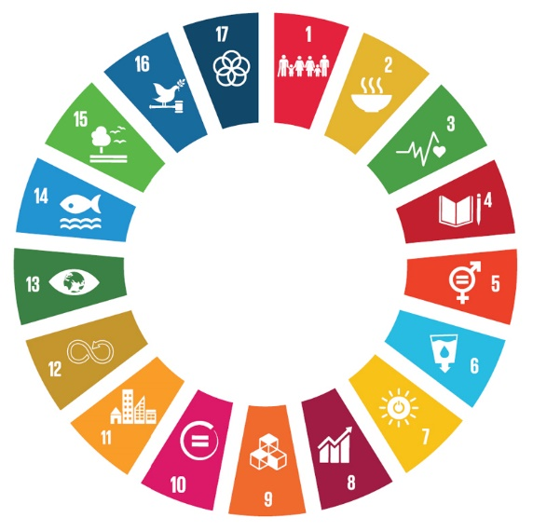
Education for Sustainable Development
Holistic learning: Head, Heart and Hands
Understanding Sustainability:
Our society’s challenges, possible solutions
Transformational Experiences: Inspiration, indignation, collective action
Competencies to Act:
Motivation, self-confidence, values, big-picture thinking, group-working skills
Taking Action:
Volunteering, projects, making a difference

Slide 10
Education2030 Links
We need a curriculum that:
· Is inclusive and supports all our students to succeed and provides them with knowledge and reading materials that reflect learning from the Global South as well as the Global North, thereby providing a way to expand the typical methodology, epistemology and pedagogy of the subject area.
· Provides students with challenges and generates curiosity.
· Offers students learning experiences that go beyond subject knowledge to provide students with the skills and abilities that enables them to influence national and global issues.
· Challenges established hierarchies and inequalities so that our students have a deeper level of understanding of the issues that affect them and how they can bring about positive social change.
· Enables students to solve problems, undertake experiential learning and be engaged as co-producers of knowledge.
· Empowers students through participation in learning experiences that give them a clear sense of civic duty.
· Gives real life learning experiences with external organisations that promote higher-level skills and knowledge to help students thrive in their future employment.
· Provides students with the skills and resources that enable them to be effective global citizens who can bring about future social and political change that can lead to a better world.
All programmes should consider how they address key DMU priorities:
Decolonising
Sustainability
Employability
Opportunities and Challenges
Immersive full-day experiences (trips, simulations)
Informal links across programmes?
Project work with external partners?

Slide 12
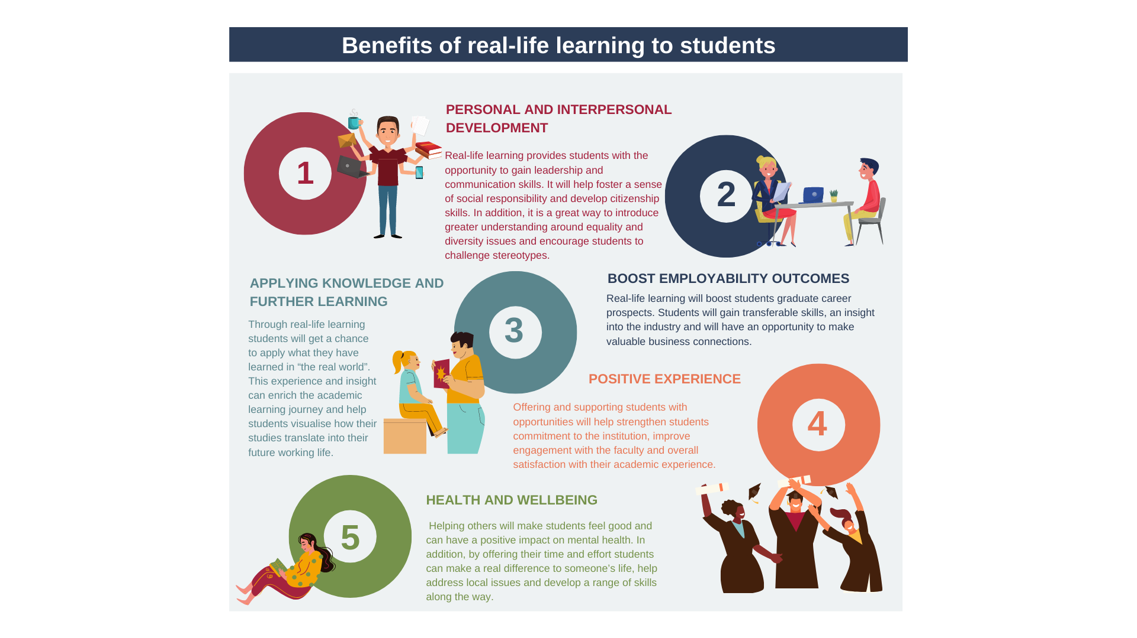

Slide 13
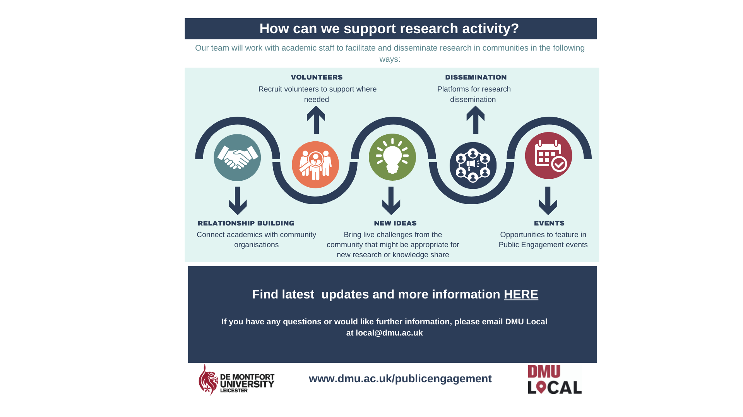

Slide 14
Next Steps
Real-Life Learning Framework
Overview and presentations: https://esdg.our.dmu.ac.uk/real-life-learning
Contact local@dmu.ac.uk
Other contacts
Faculty employability teams
Sustainability team and ESD project (sustainability@dmu.ac.uk)
Living Labs framework
Use to consider how to strengthen links between teaching/research/impact for any activity
https://esdg.our.dmu.ac.uk/staff/planning-toolkits/
Case Studies of practice
https://esdg.our.dmu.ac.uk/staff/case-studies/
Further case studies on R-L Learning coming soon
Share your own practice (pro-forma available)

