Slide 1
Student Sustainability Showcase
Dr Andrew Reeves
Wednesday 11th May 2022

Slide 2
Session Plan
Agenda:
Speed networking
Short presentations
Linking activities between Leicester and Dubai
What next? Offers and requests for the next year (including to/by the societies present and Sustainability Team) (Andrew Reeves)
Close

Slide 3
Speed Networking
Introductions: Name and Course
A sustainability issue you’re passionate about or interested in
Something you’ve done this year

Slide 4
Presentations
DMU Dubai Sustainability Hub (Ashwin Sridharan Kundrathala and Neel Jumnani - ONLINE)
Enactus DMU: Activities in 2021/22 (Tarnjeet Kaur)
DMU Caribbean Society (Dennis McCall Jr)
Sustainability in Masters Research (Philomena Imade-Omoregie Osagie)
Sustainability in Fashion (Nayaab Mahomed)
More!

Slide 5
DMU Caribbean Society

Slide 7
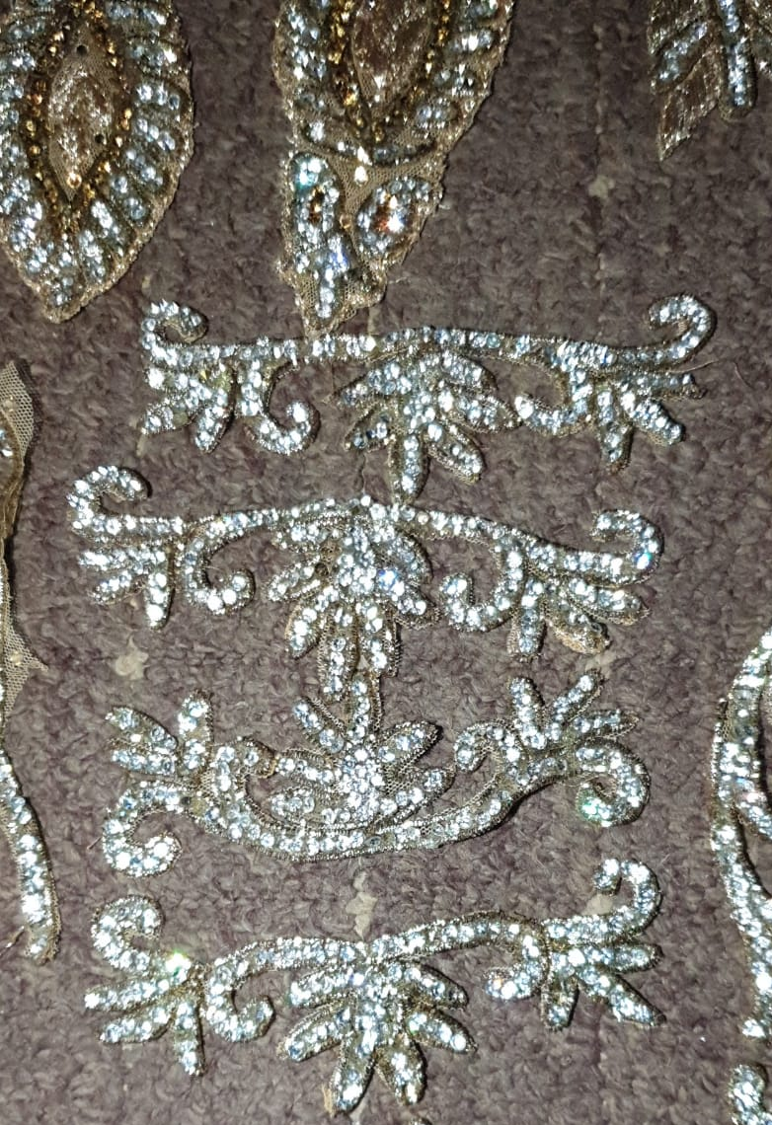
Sustainability in Fashion
Nayaab Mahomed
BA Fashion Design
P2540938@my365.dmu.ac.uk

Slide 8
Other Things to Share?

Slide 9
Links with Dubai
How can DMU students link up and work together across courses and between UK and Dubai?

Slide 10
What Next?
Offers and requests

Slide 11
Q&A and Thanks

