Slide 1
DMU’s SOS Skills Survey Data 2016 -2023
By the DMU Sustainability team

Slide 2
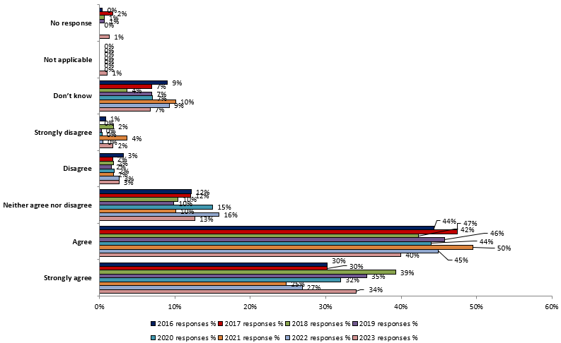
My university / college takes action to limit negative effect it has on people and the environment

Slide 3
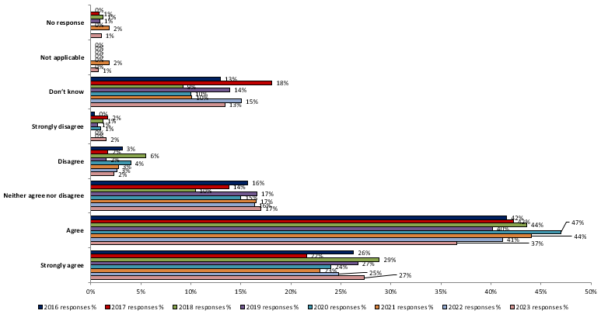
My students' union takes action to limit negative effect it has on people and the environment

Slide 4
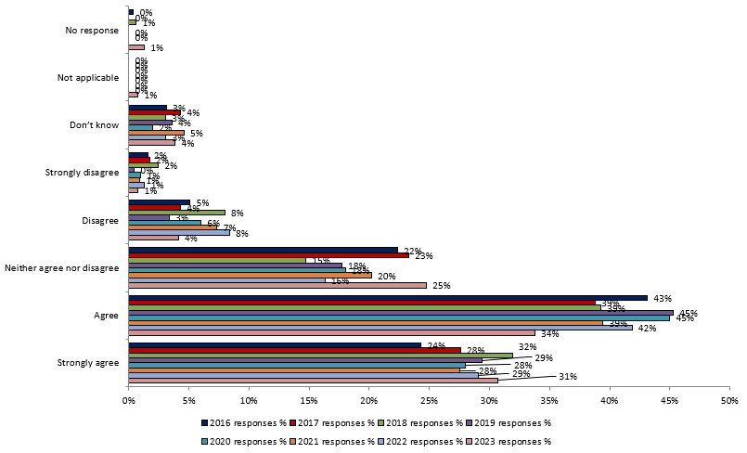
Being a student at my university / college encourages me to think and act to help the environment, and other people

Slide 5
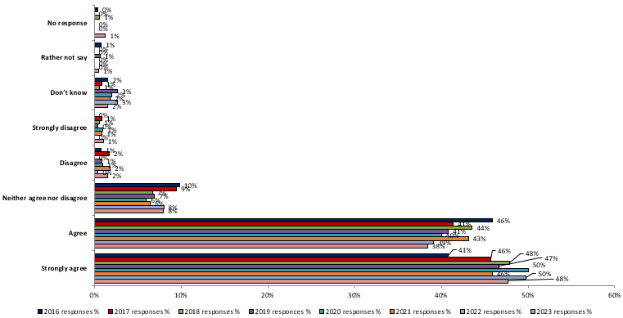
Sustainable development is something which universities / college should actively incorporate and promote

Slide 6
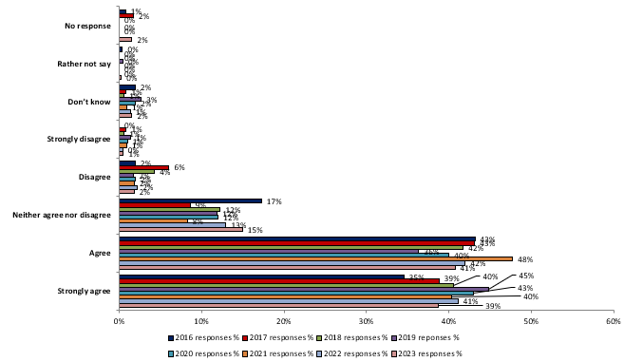
Sustainable development is something which all university / college courses should actively incorporate and promote

Slide 7
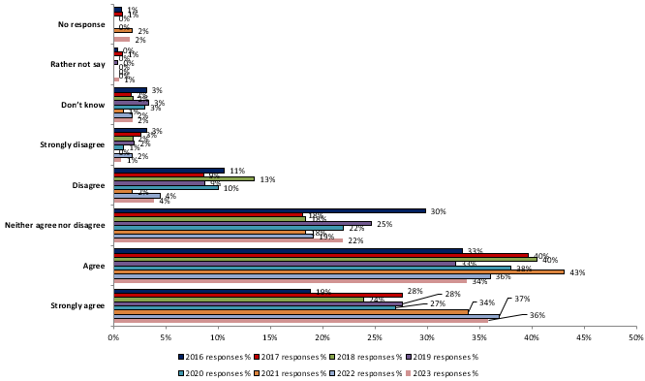
Sustainable development is something all course tutors should be required to incorporate within their teaching

Slide 8
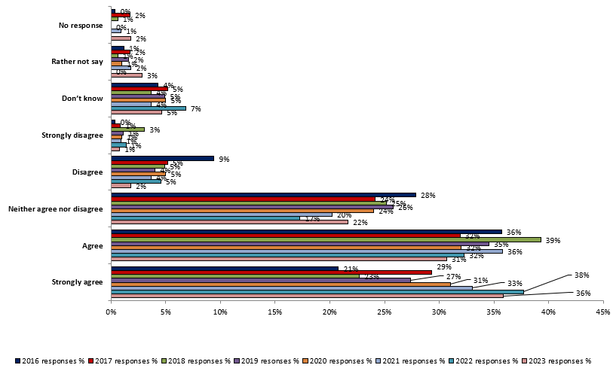
Sustainable development is something which I would like to know more about

Slide 9
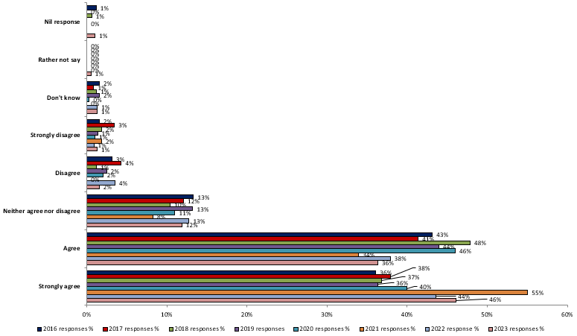
To what extent, if any, do you agree that universities / colleges should be obliged to develop student's social and environmental skills as part of their course?

