Slide 1
DMU’s SOS Skills Survey Data 2016 -2023
By the DMU Sustainability team

Slide 2
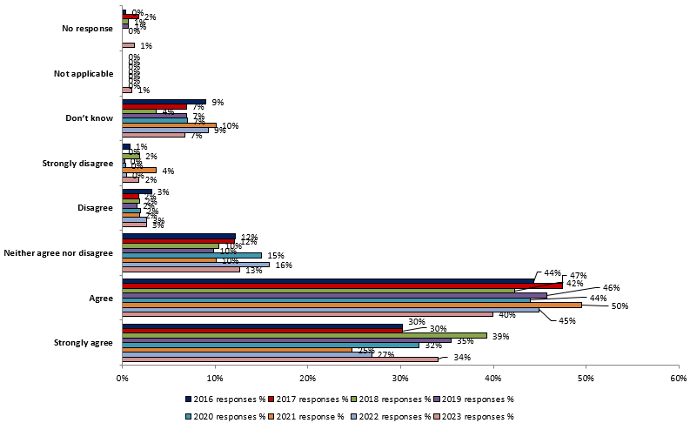
My university / college takes action to limit negative effect it has on people and the environment

Slide 3
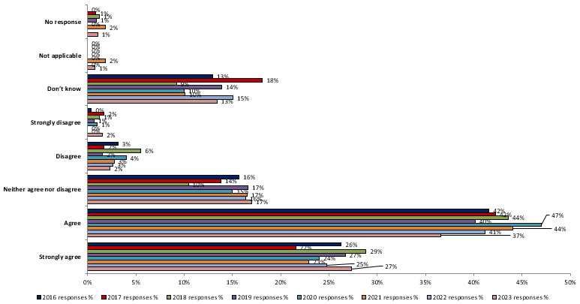
My students' union takes action to limit negative effect it has on people and the environment

Slide 4
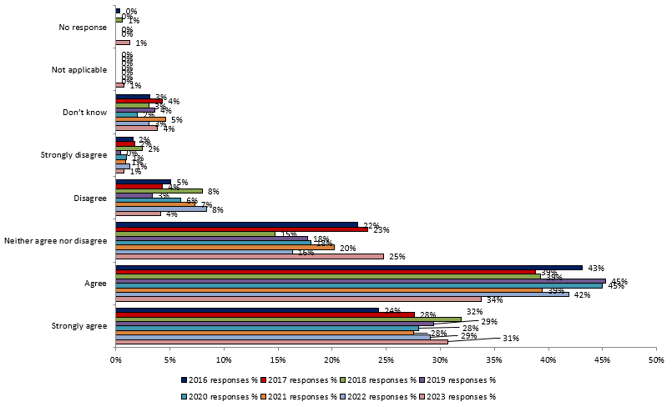
Being a student at my university / college encourages me to think and act to help the environment, and other people

Slide 5
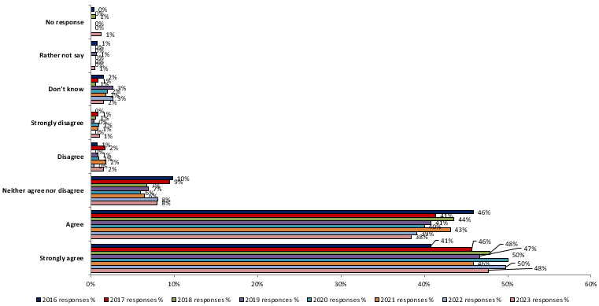
Sustainable development is something which universities / college should actively incorporate and promote

Slide 6
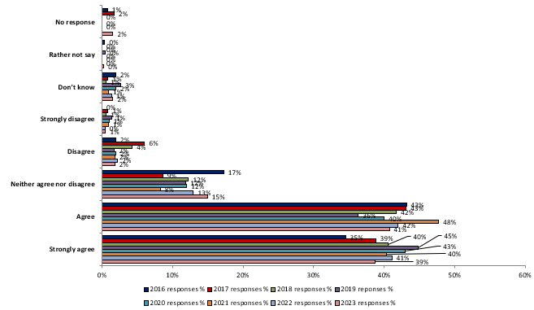
Sustainable development is something which all university / college courses should actively incorporate and promote

Slide 7
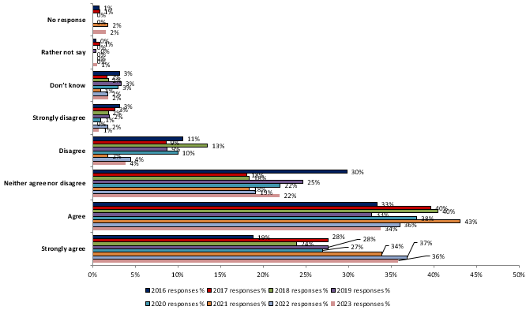
Sustainable development is something all course tutors should be required to incorporate within their teaching

Slide 8
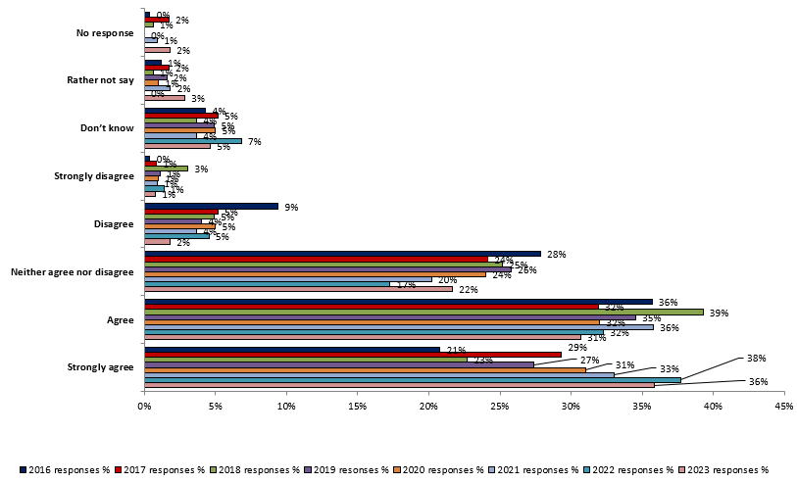
Sustainable development is something which I would like to know more about

Slide 9
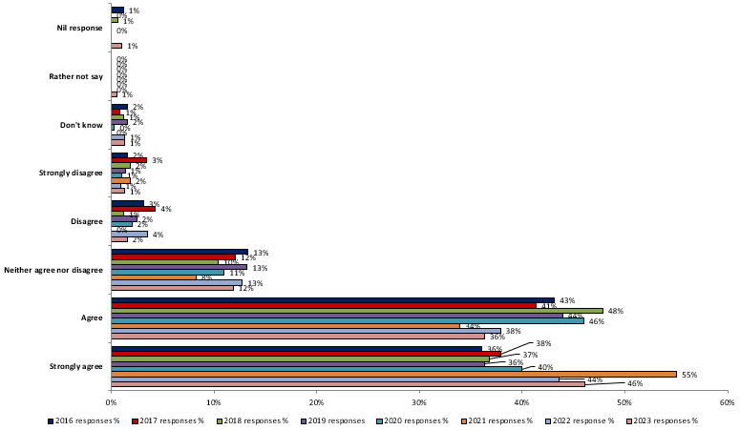
To what extent, if any, do you agree that universities / colleges should be obliged to develop student's social and environmental skills as part of their course?

Slide 10
Thinking of your time in education so far, which of the following issues have been covered in University teaching?

Slide 11
How important do you think the following skills and knowledge are to your future employers?

Slide 12
To what extent do you agree or disagree with the following statement: “Through my time in education so far, I’ve learnt…”

