Slide 1
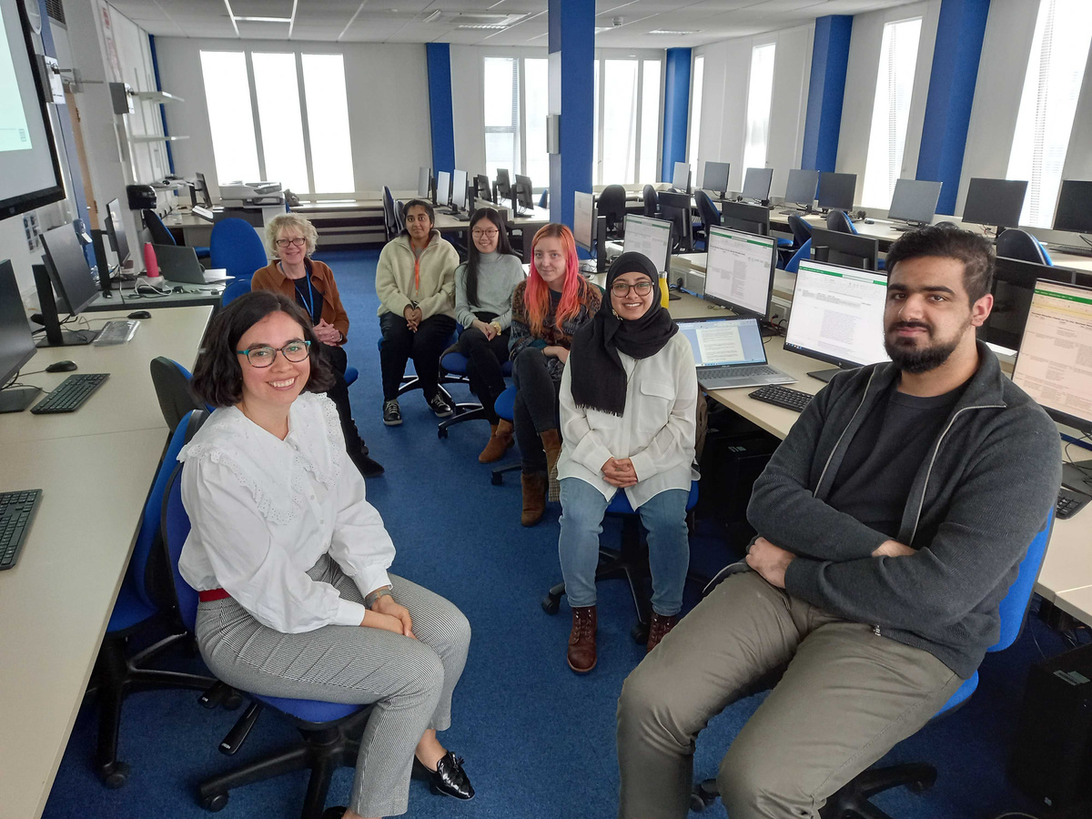
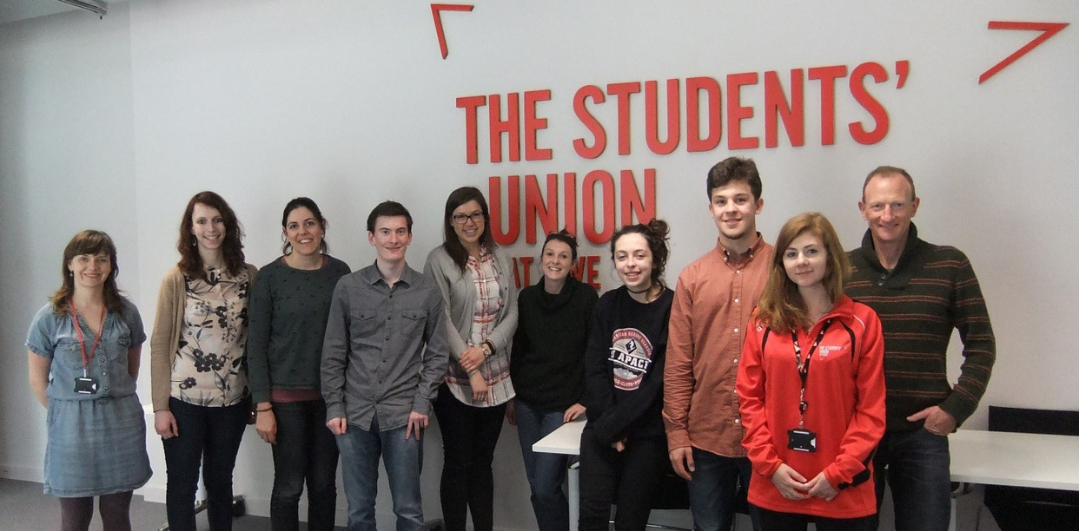

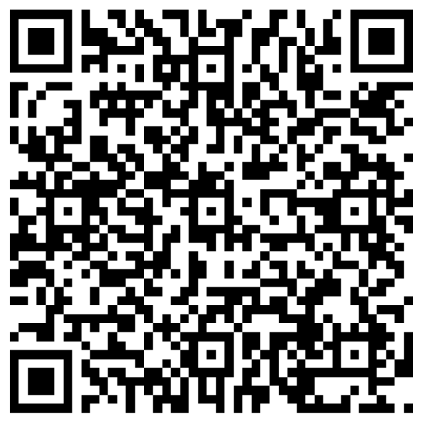





Green Skills for
Green Jobs Workshops
Sign Up:
Weds 21st January (2-4pm, online)
OR
Weds 4th February (10am-12pm, hybrid at DMU)
Join students, staff, and local employers to explore the future of green skills in UK Higher Education in a research workshop
£15 voucher for students participating!

